Slide 1
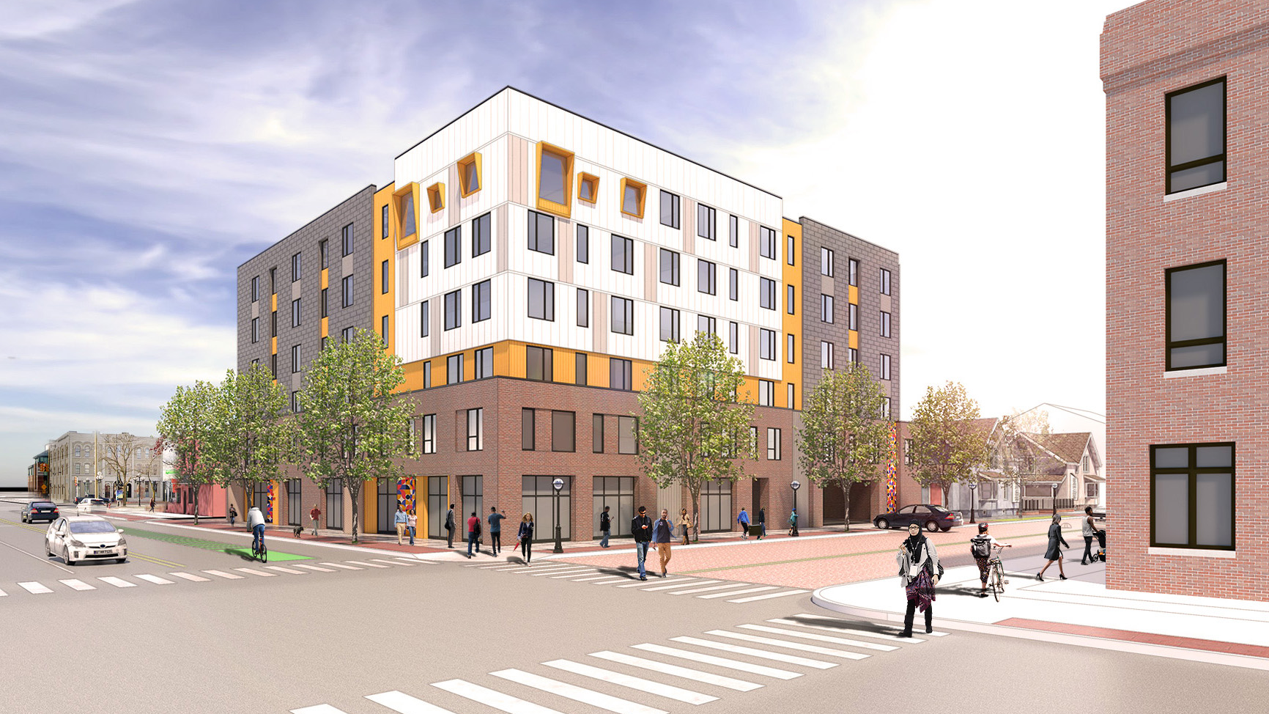
Dunbar Tower
ANN ARBOR, MI

Slide 2



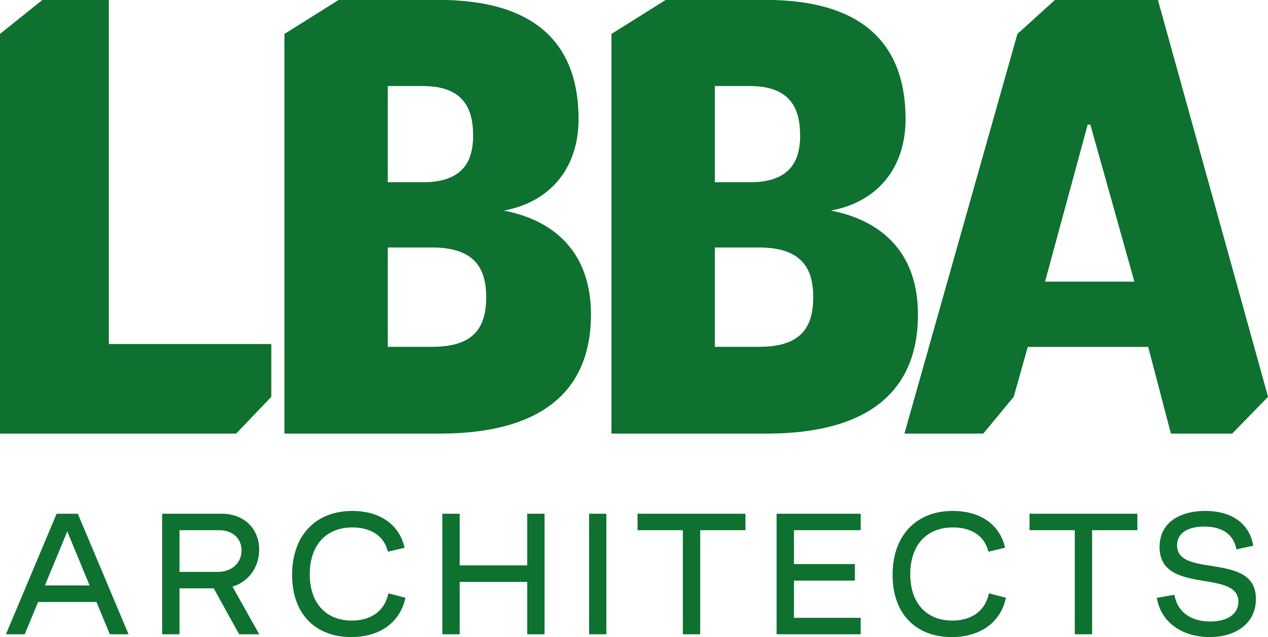

Project Partners
DEVELOPMENT PARTNERS
Avalon Housing Inc. & Ann Arbor Housing Commission
ARCHITECT
LBBA
CONTRACTOR
O'Neal Construction Inc.
MEP
Strategic Energy Solutions, Inc.
STRUCTURAL
IMEG Corporation
CIVIL & LANDSCAPE
Macon Engineering, Inc.
ENVIRONMENTAL CONSULTANT
Environmental Consulting and Technology, Inc.
GREEN CONSULTANT
Elevate Energy

Slide 3
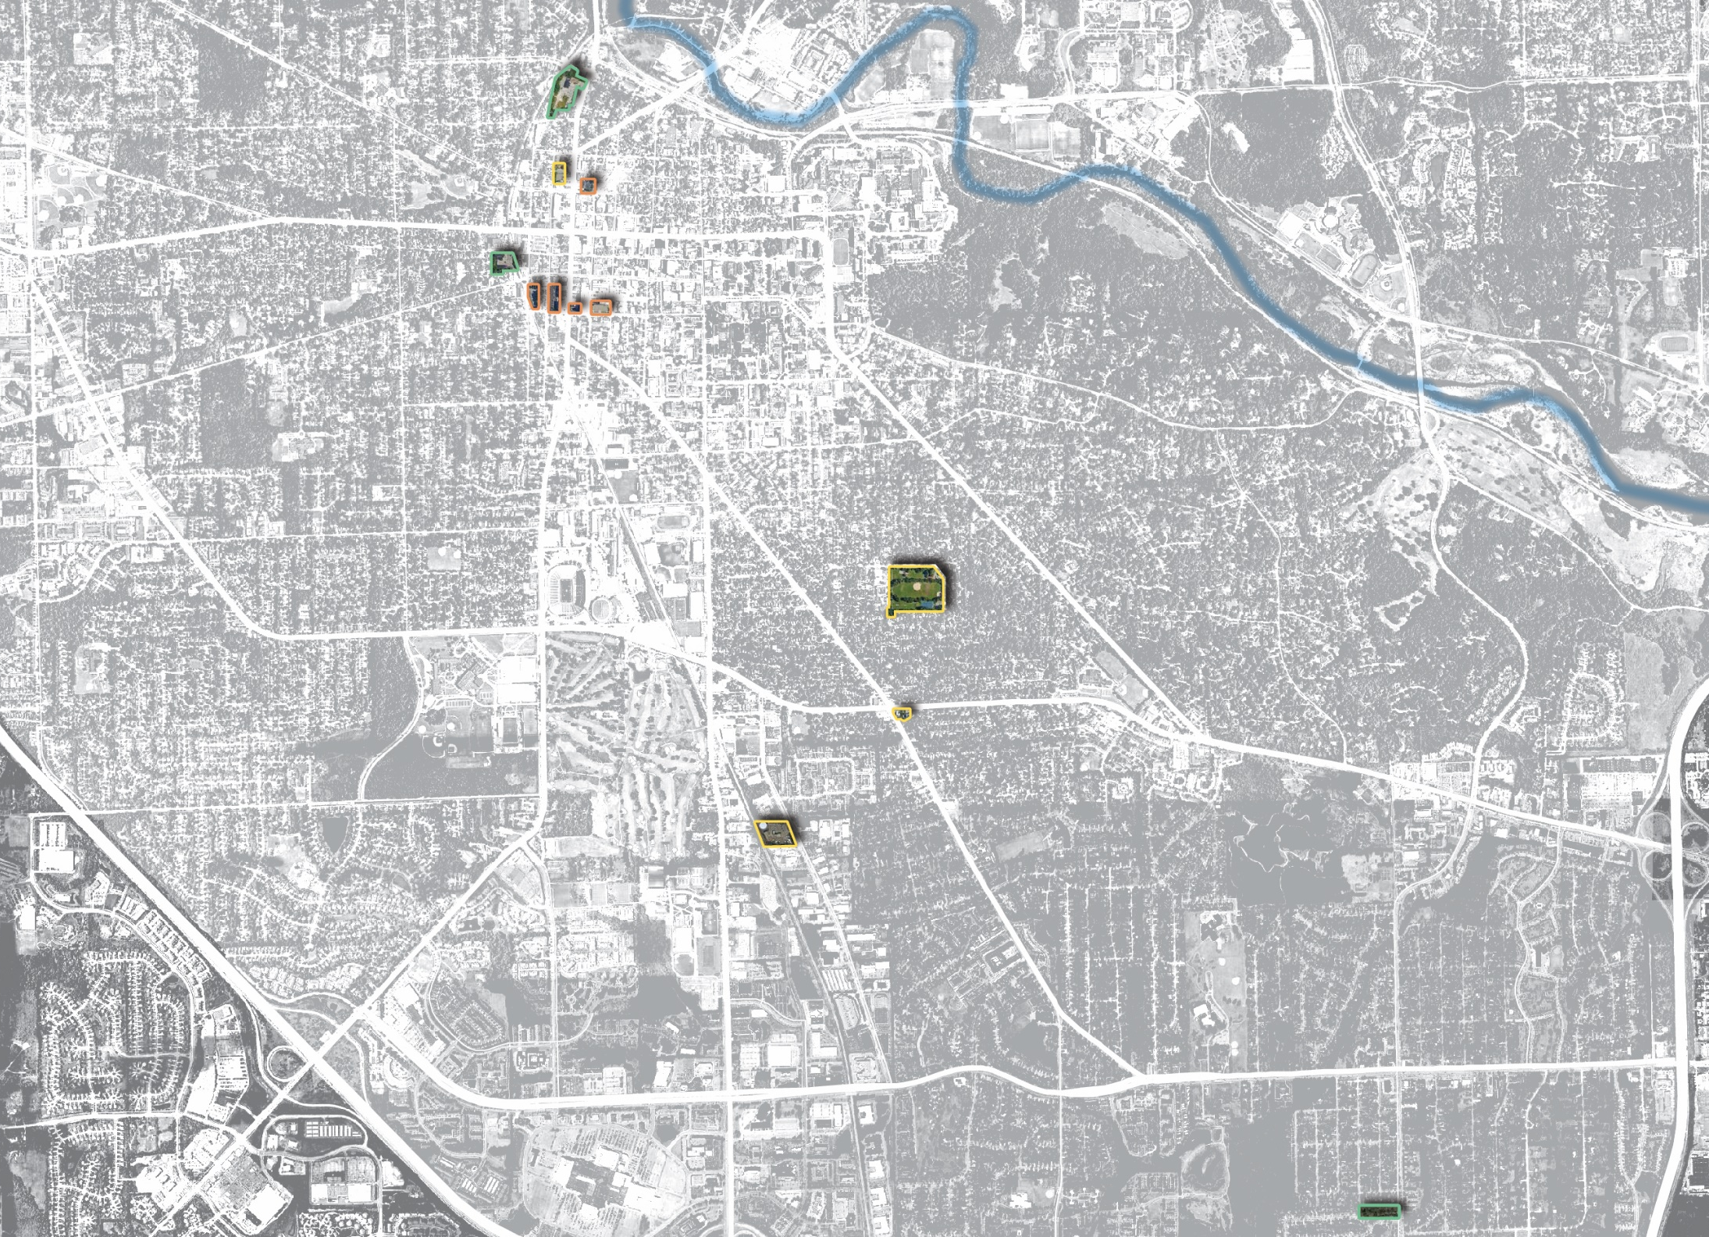
City-Owned Potential Housing Sites
721 N. Main
121 Catherine
Huron Ave
404 – 406 N Ashley
350 S. Fifth Ave
415 W. Washington
216 W. William
353 S. Main
Washtenaw Ave
Building / Facilities
1320 Baldwin Ave
Stadium Blvd
104 -120 W. William
Surface Parking Lots
State St
Main St
Stadium Blvd
1510 E. Stadium
Ann Arbor Saline Rd
2000 S. Industrial
Packard St
Vacant Properties
US 23
Packard St
3432 - 3440 Platt & 3435 – 3443 Springbrook
Eisenhower Pkwy

Slide 4
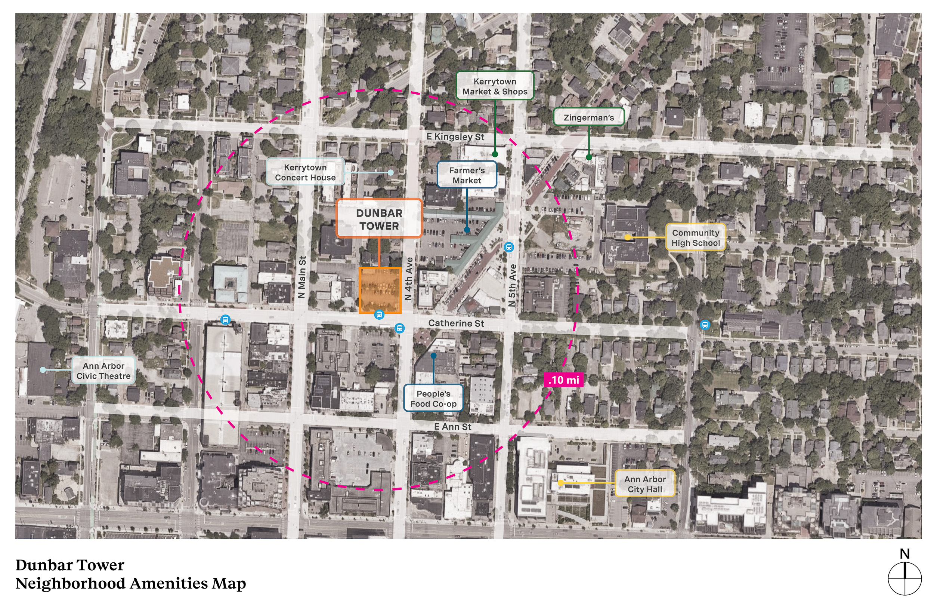

Slide 5
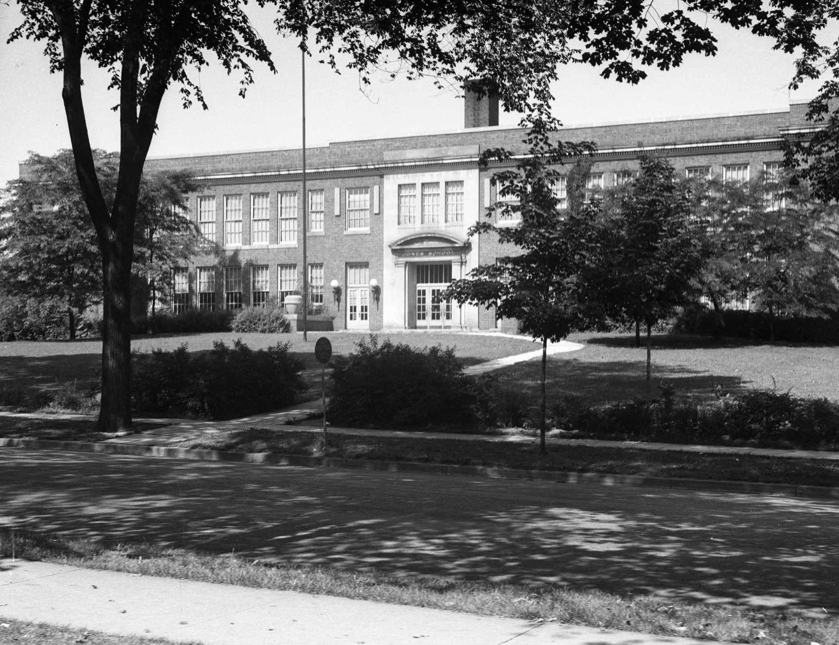
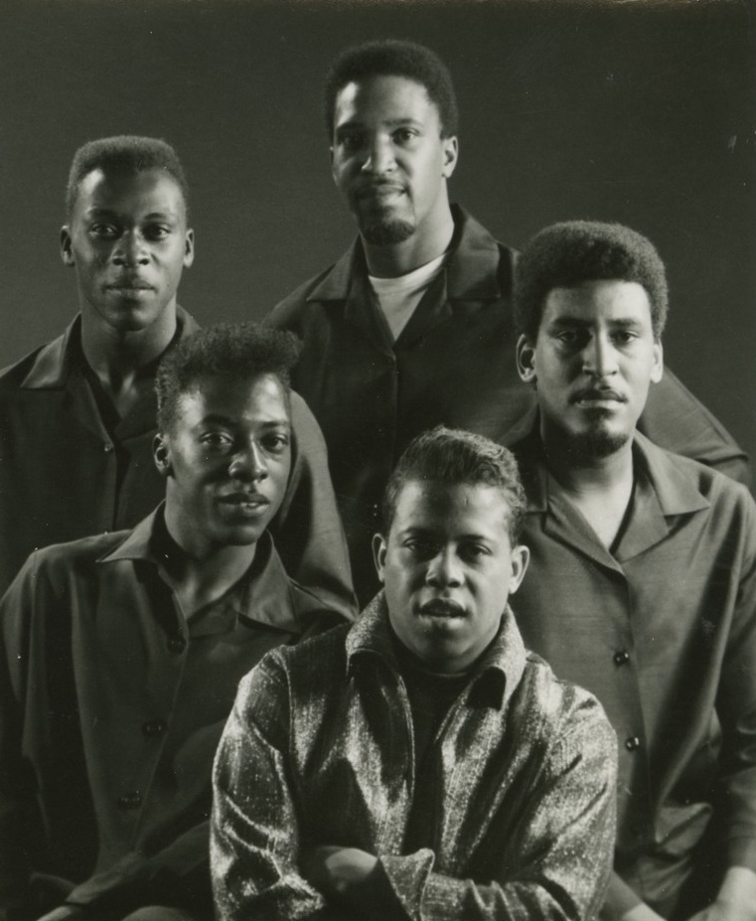
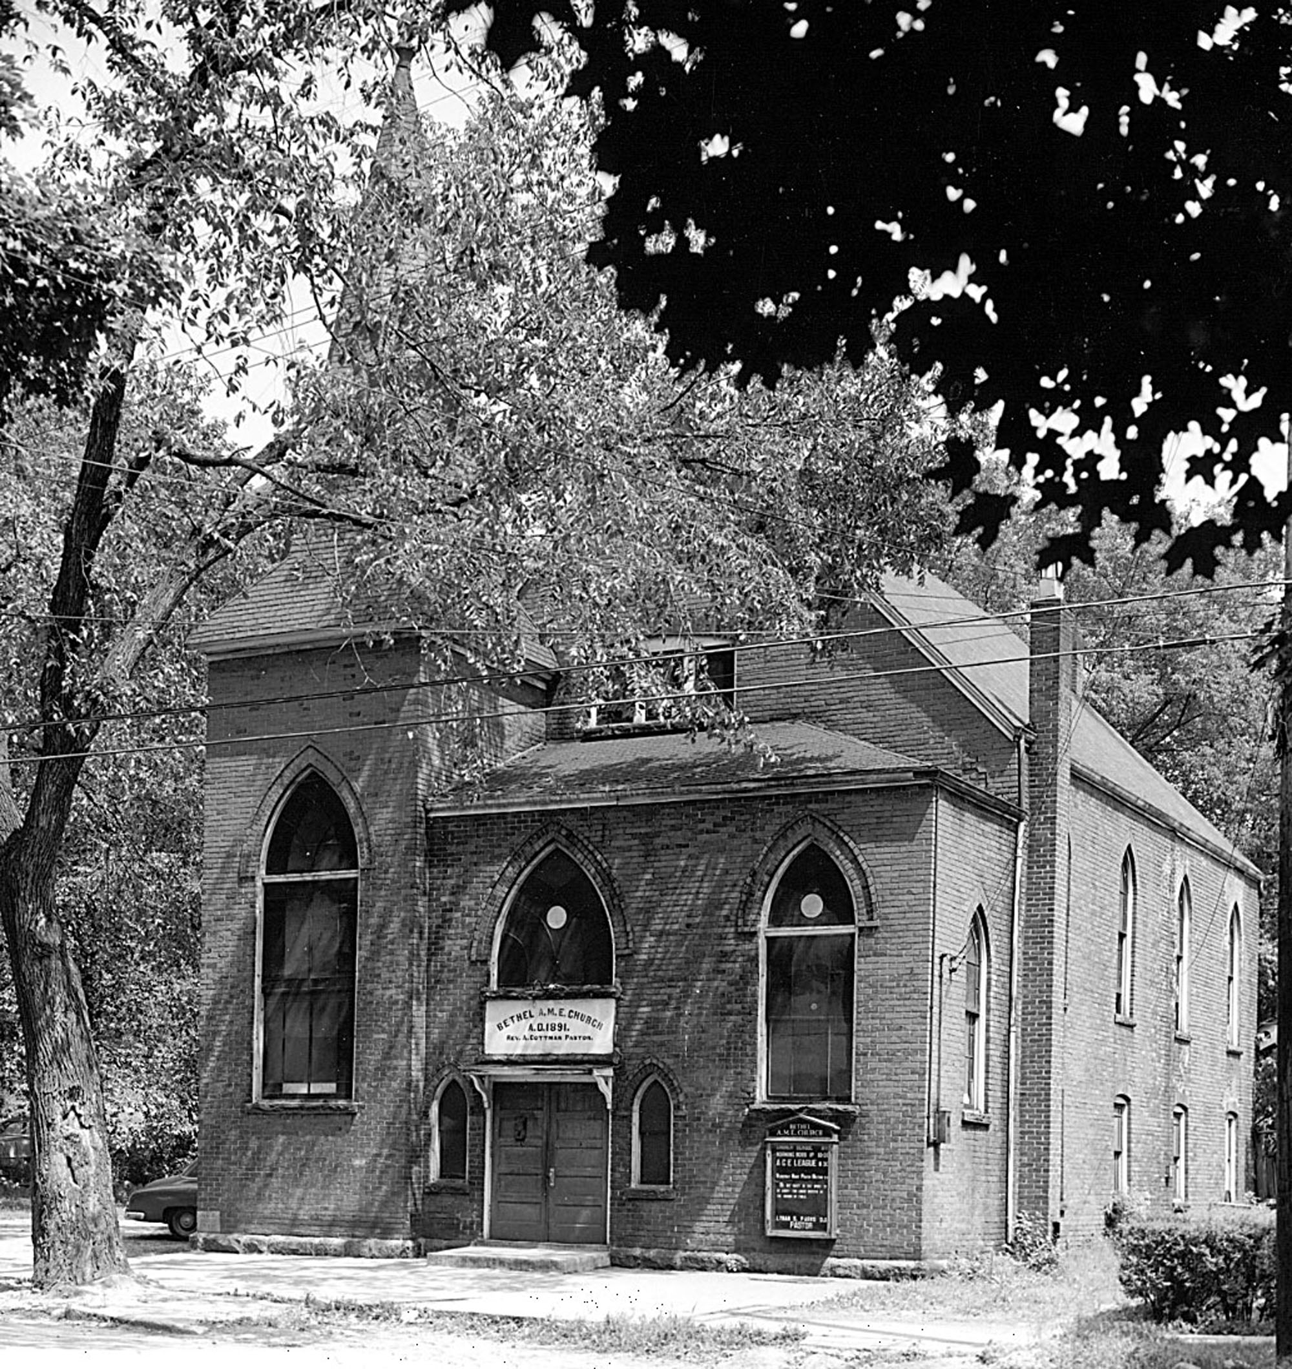
undated
Historical Context
Jones Elementary School – 1964 Currently Community High School
Original Bethel AME Church 1945

Slide 6
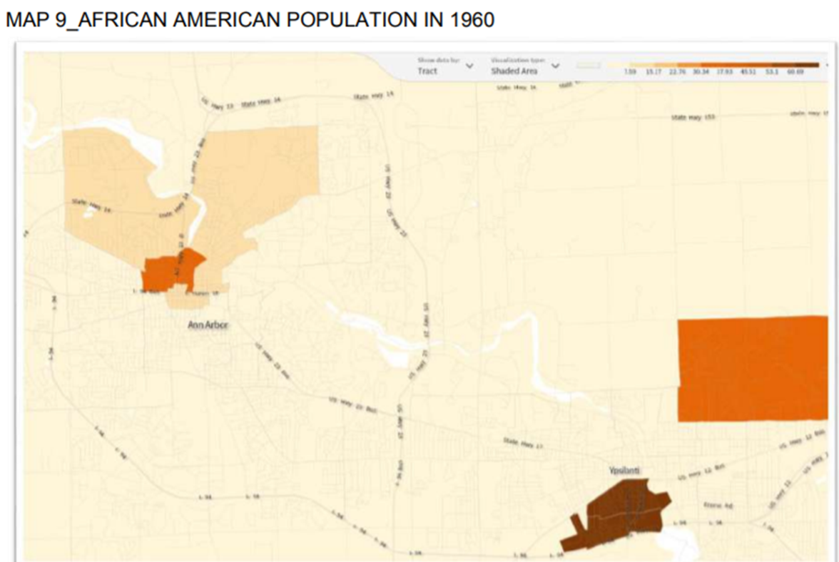
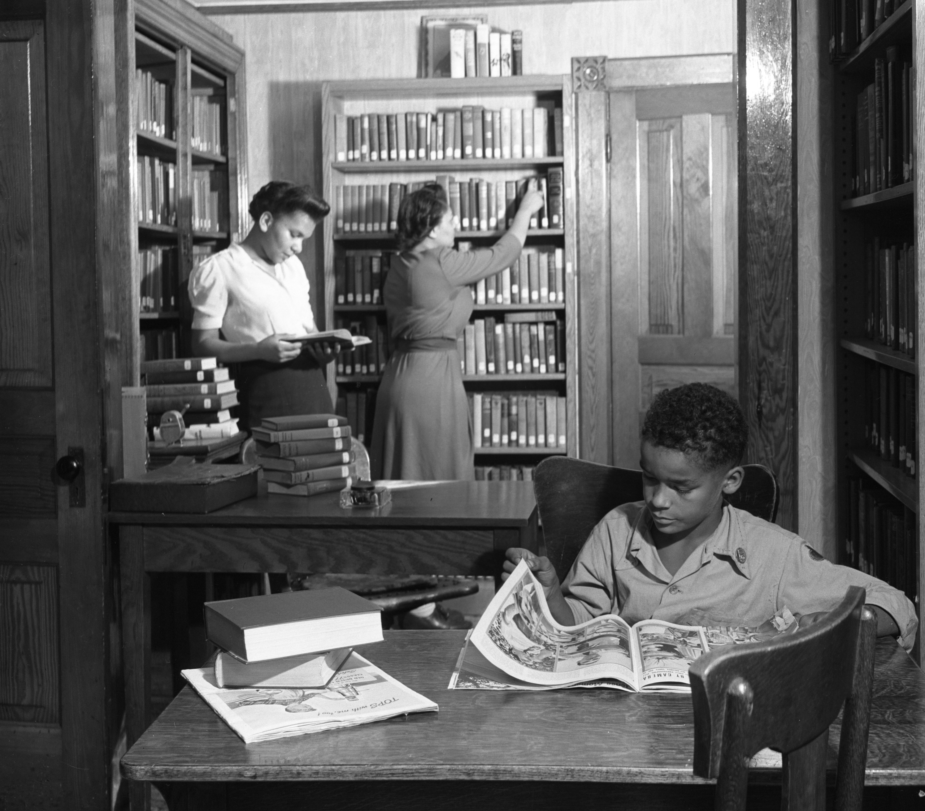
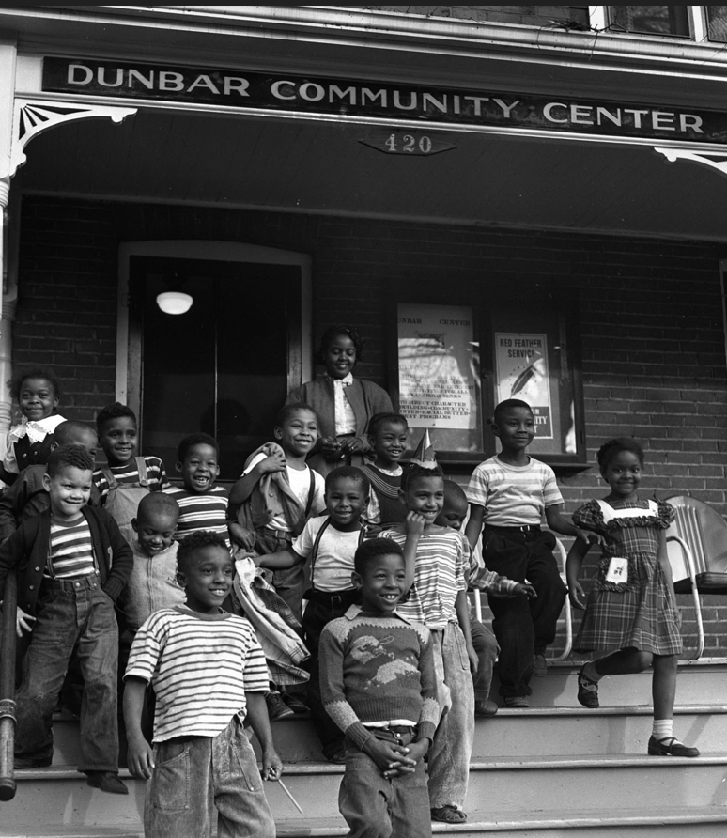
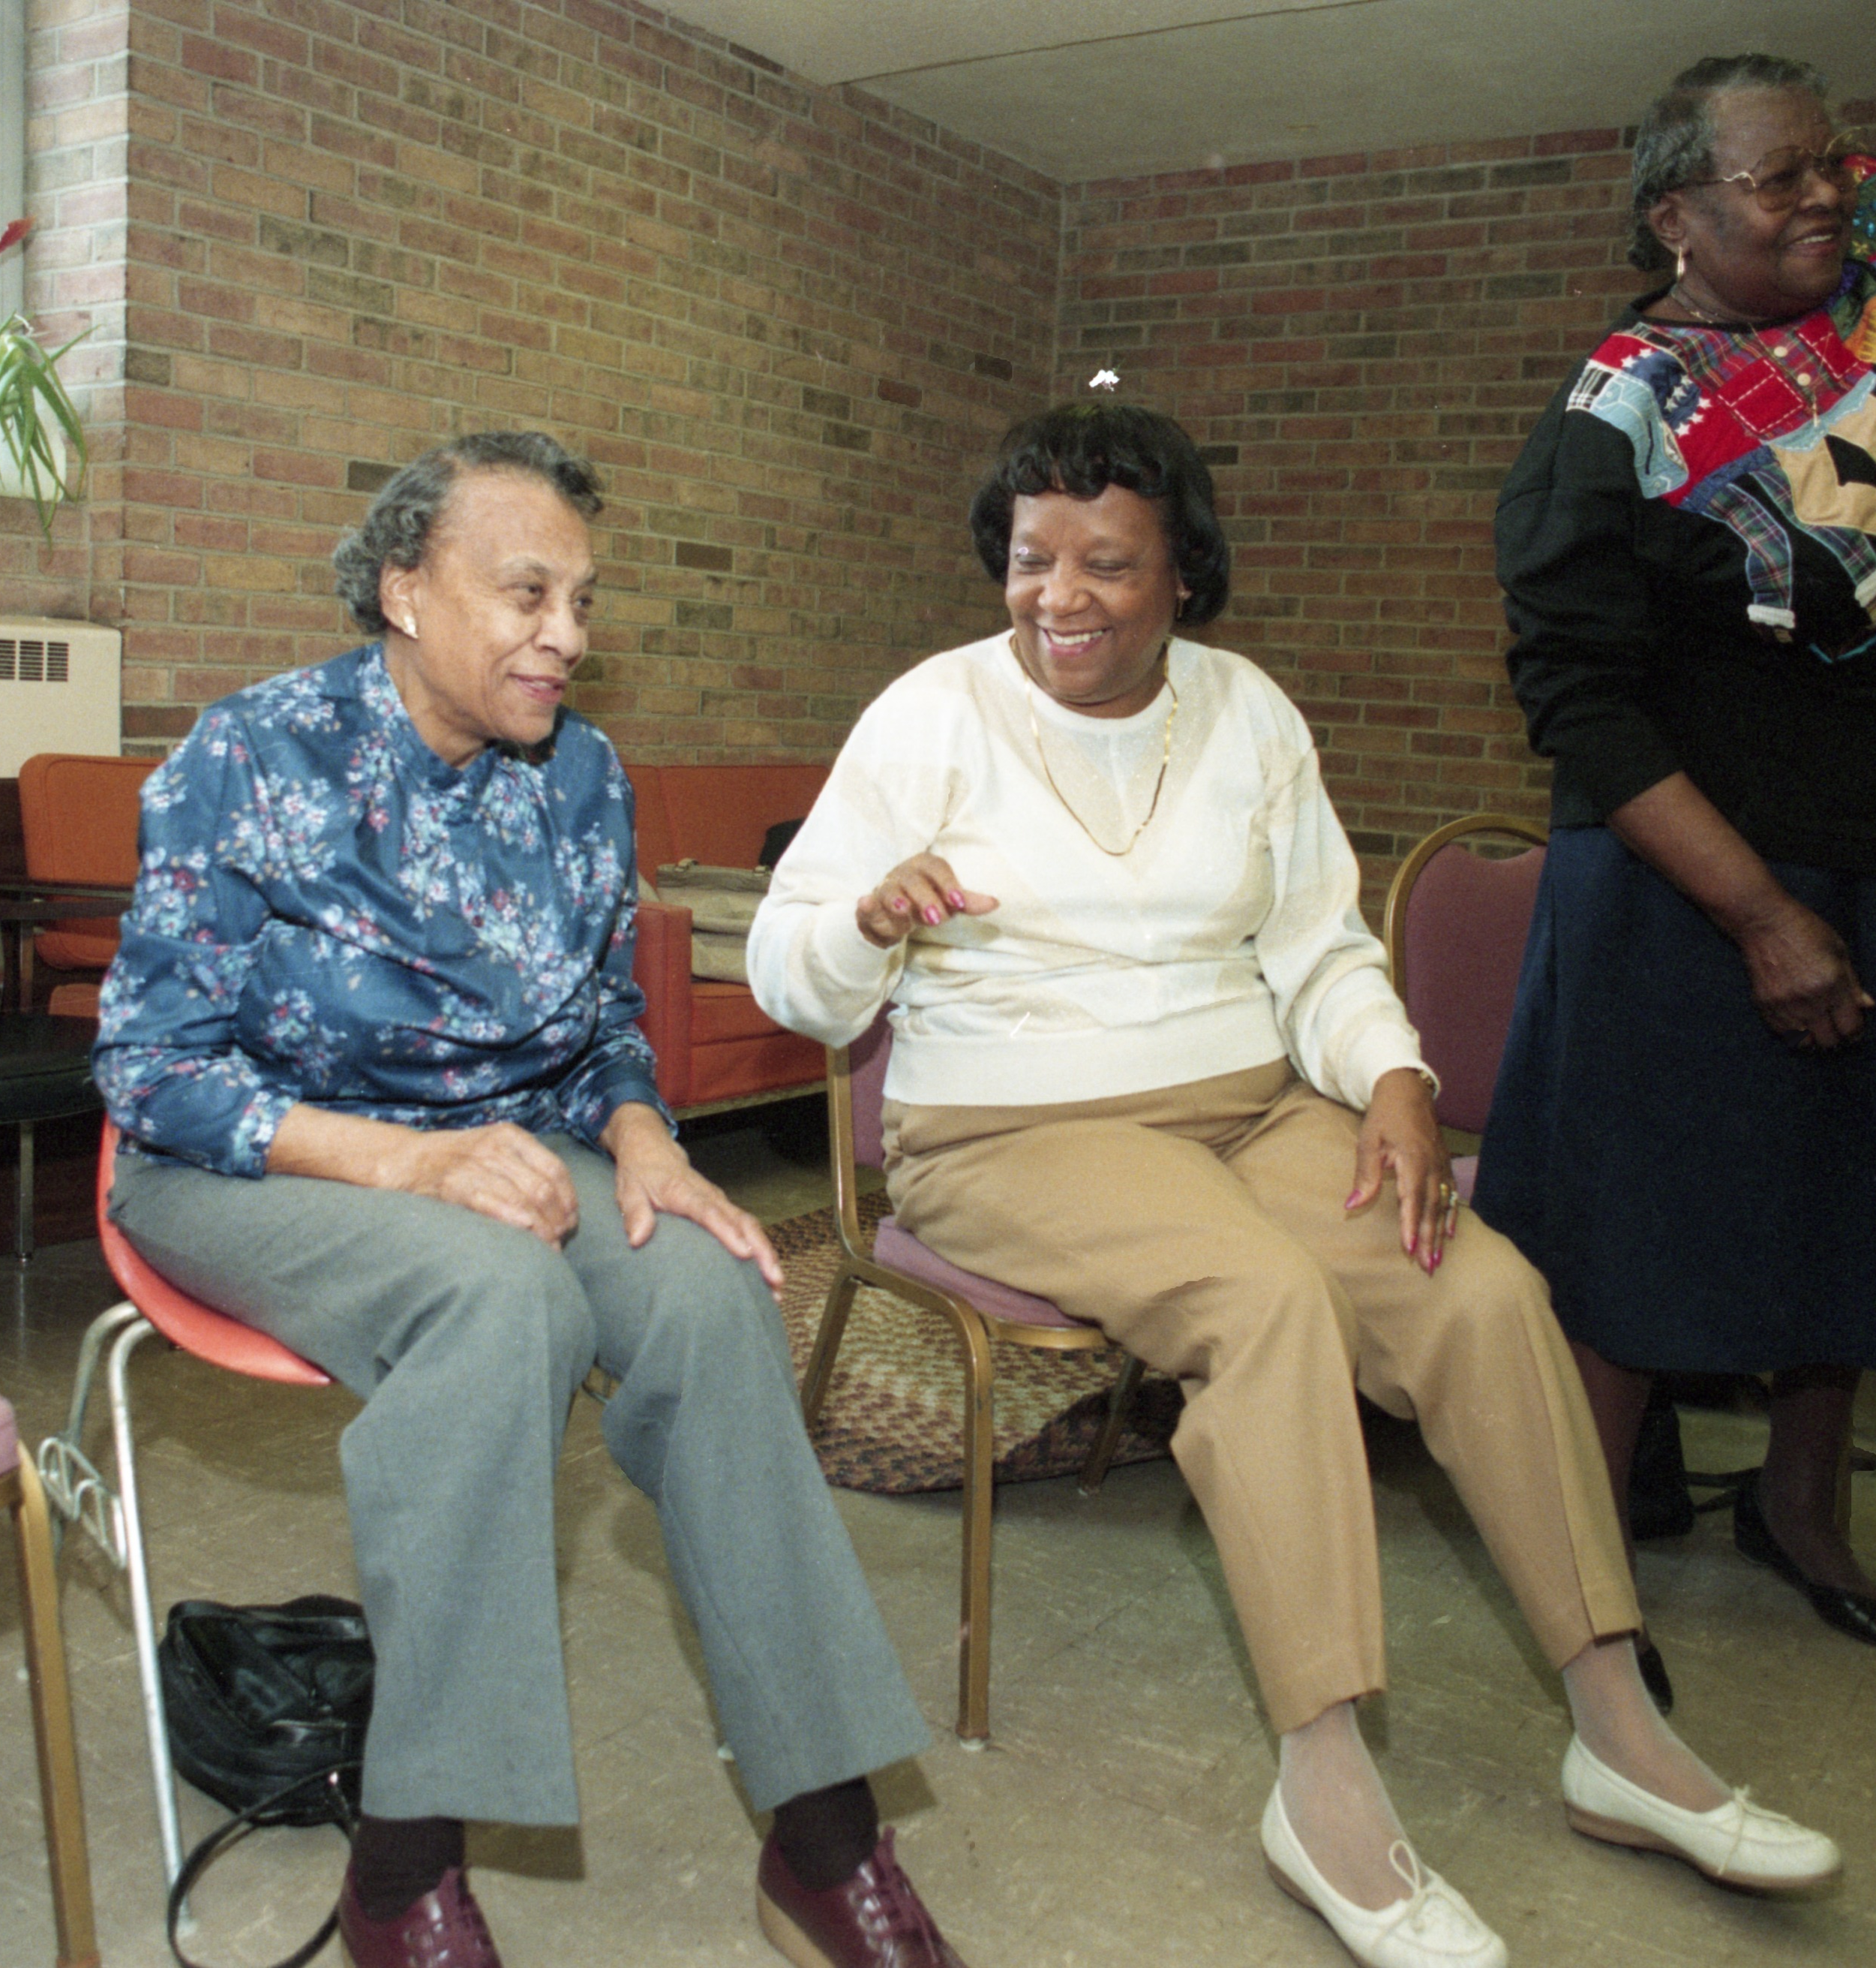
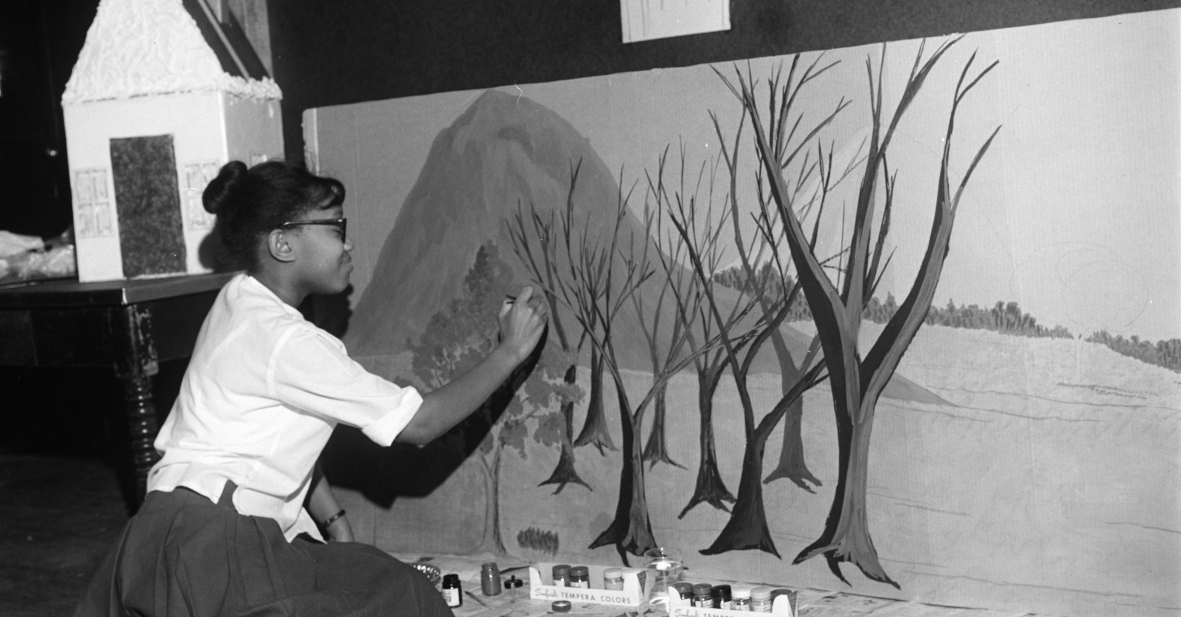
Historically a Black Neighborhood
Dunbar Center Library, 1944
Map of African American Population in 1960
Preparing for Puppet Show, 1963
Senior Chair Exercises, 1995
Dunbar Center, 1951

Slide 7
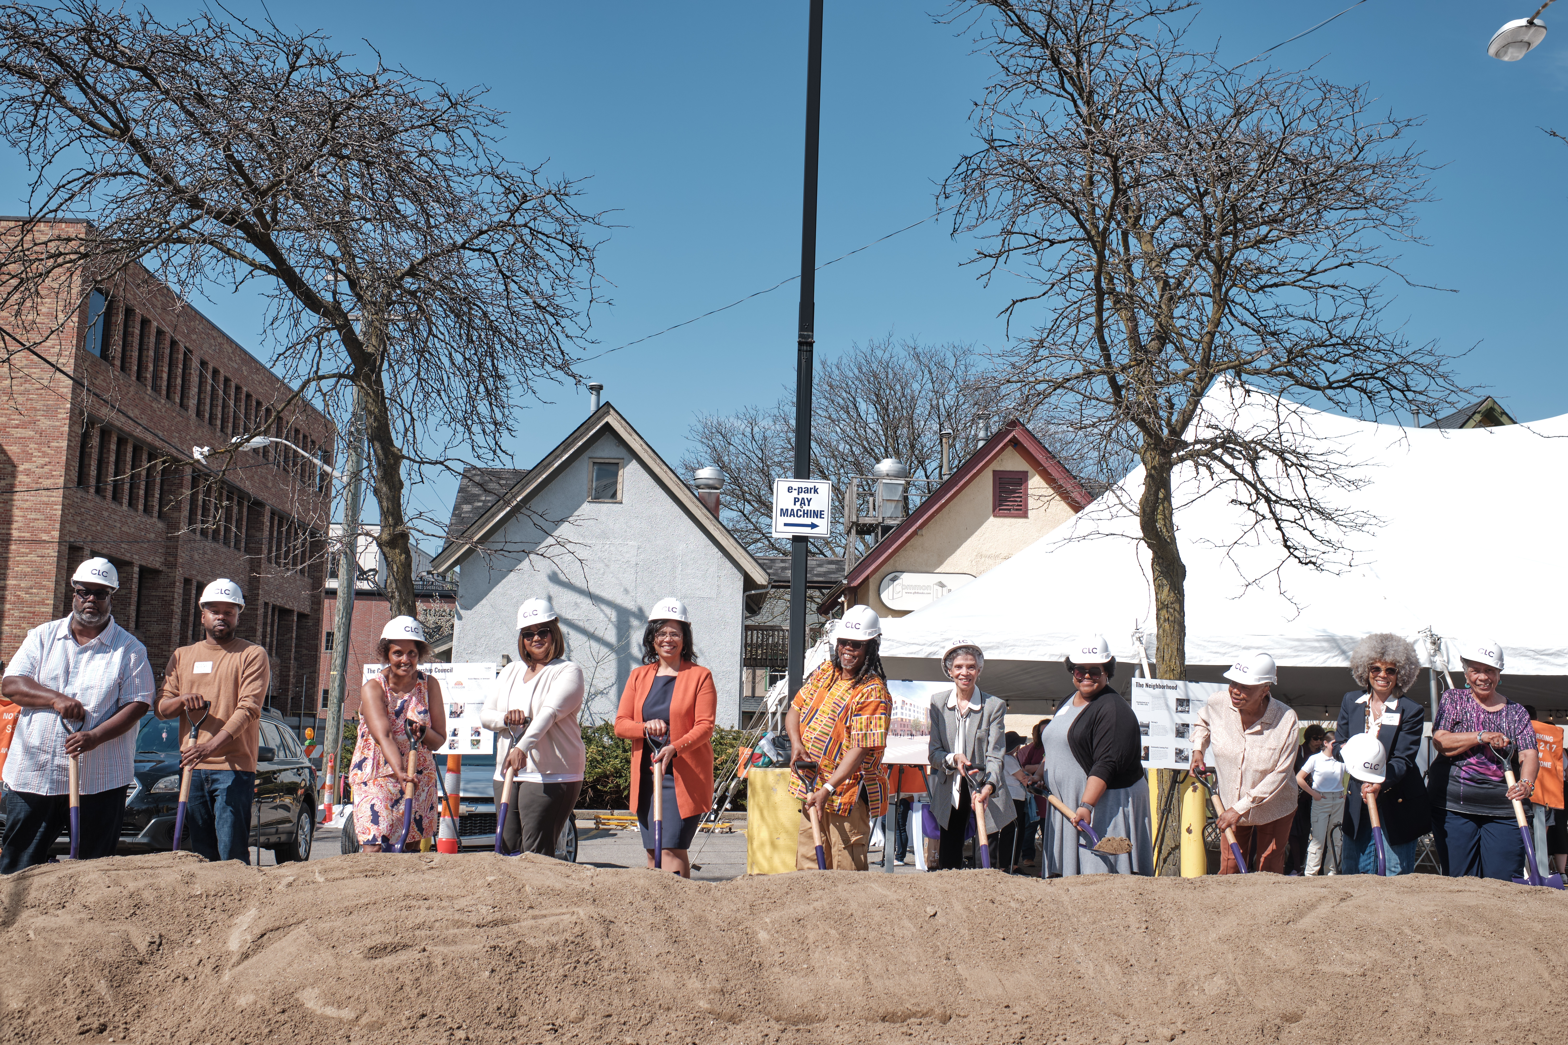
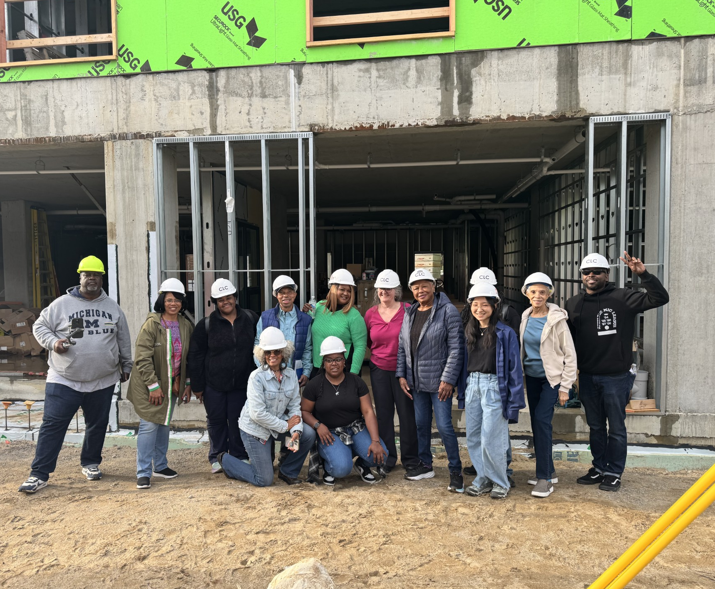
Community Leadership Council (CLC)
The CLC is a community advisory board that brings together multi-generational Black current and former residents of the neighborhood, including local Black artists and entrepreneurs.
Notes:
More photos or info

Slide 8
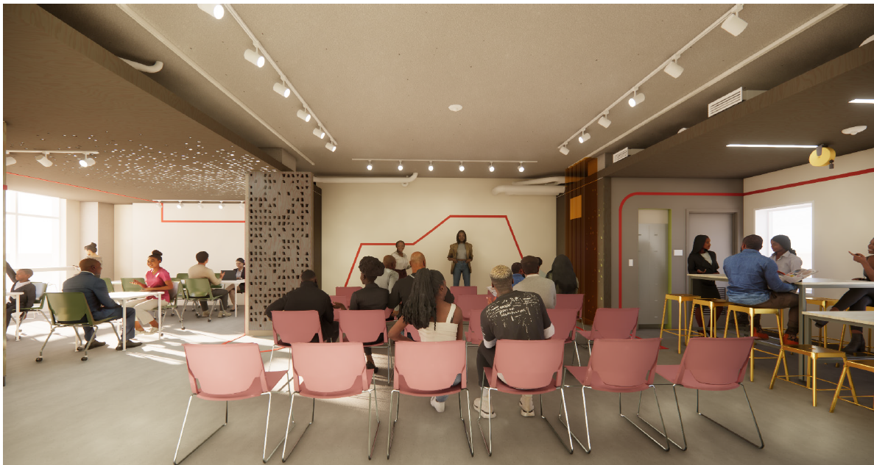
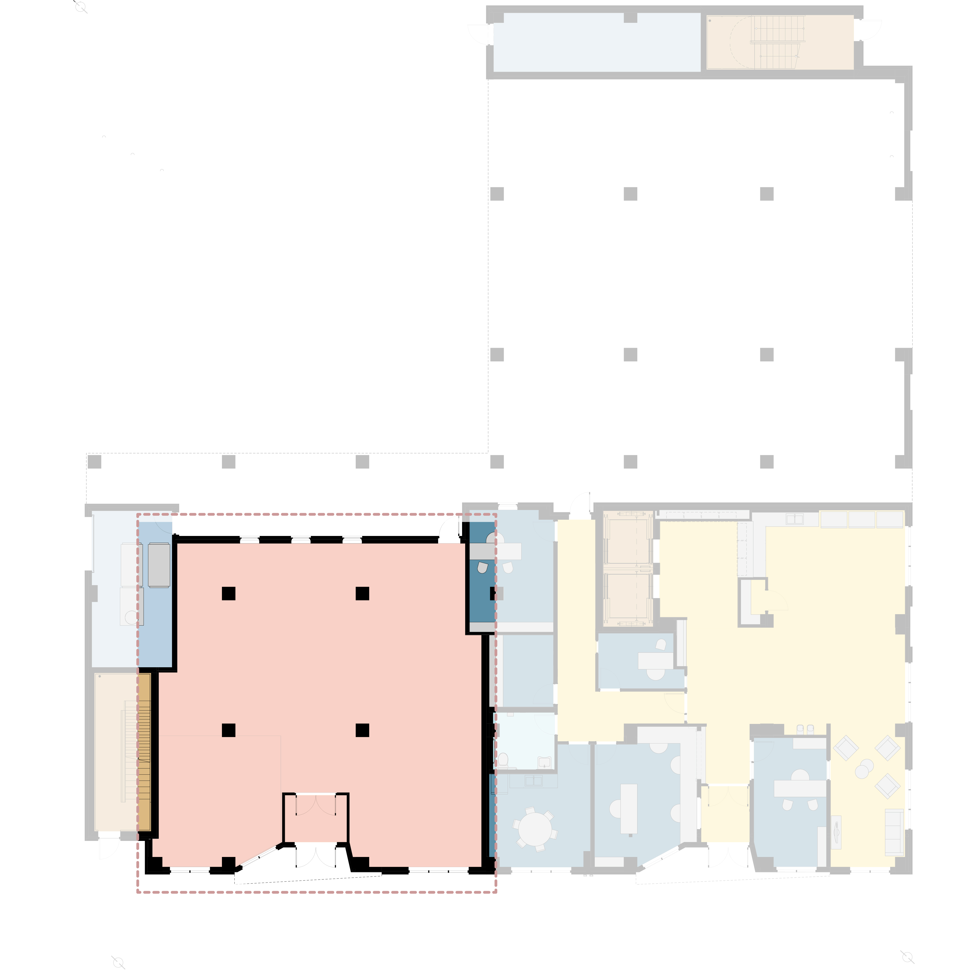
Celebrate & Honor the History & Culture
CLC Public Community Space
2,096 sq ft
4TH AVE
CATHERINE ST

Slide 9

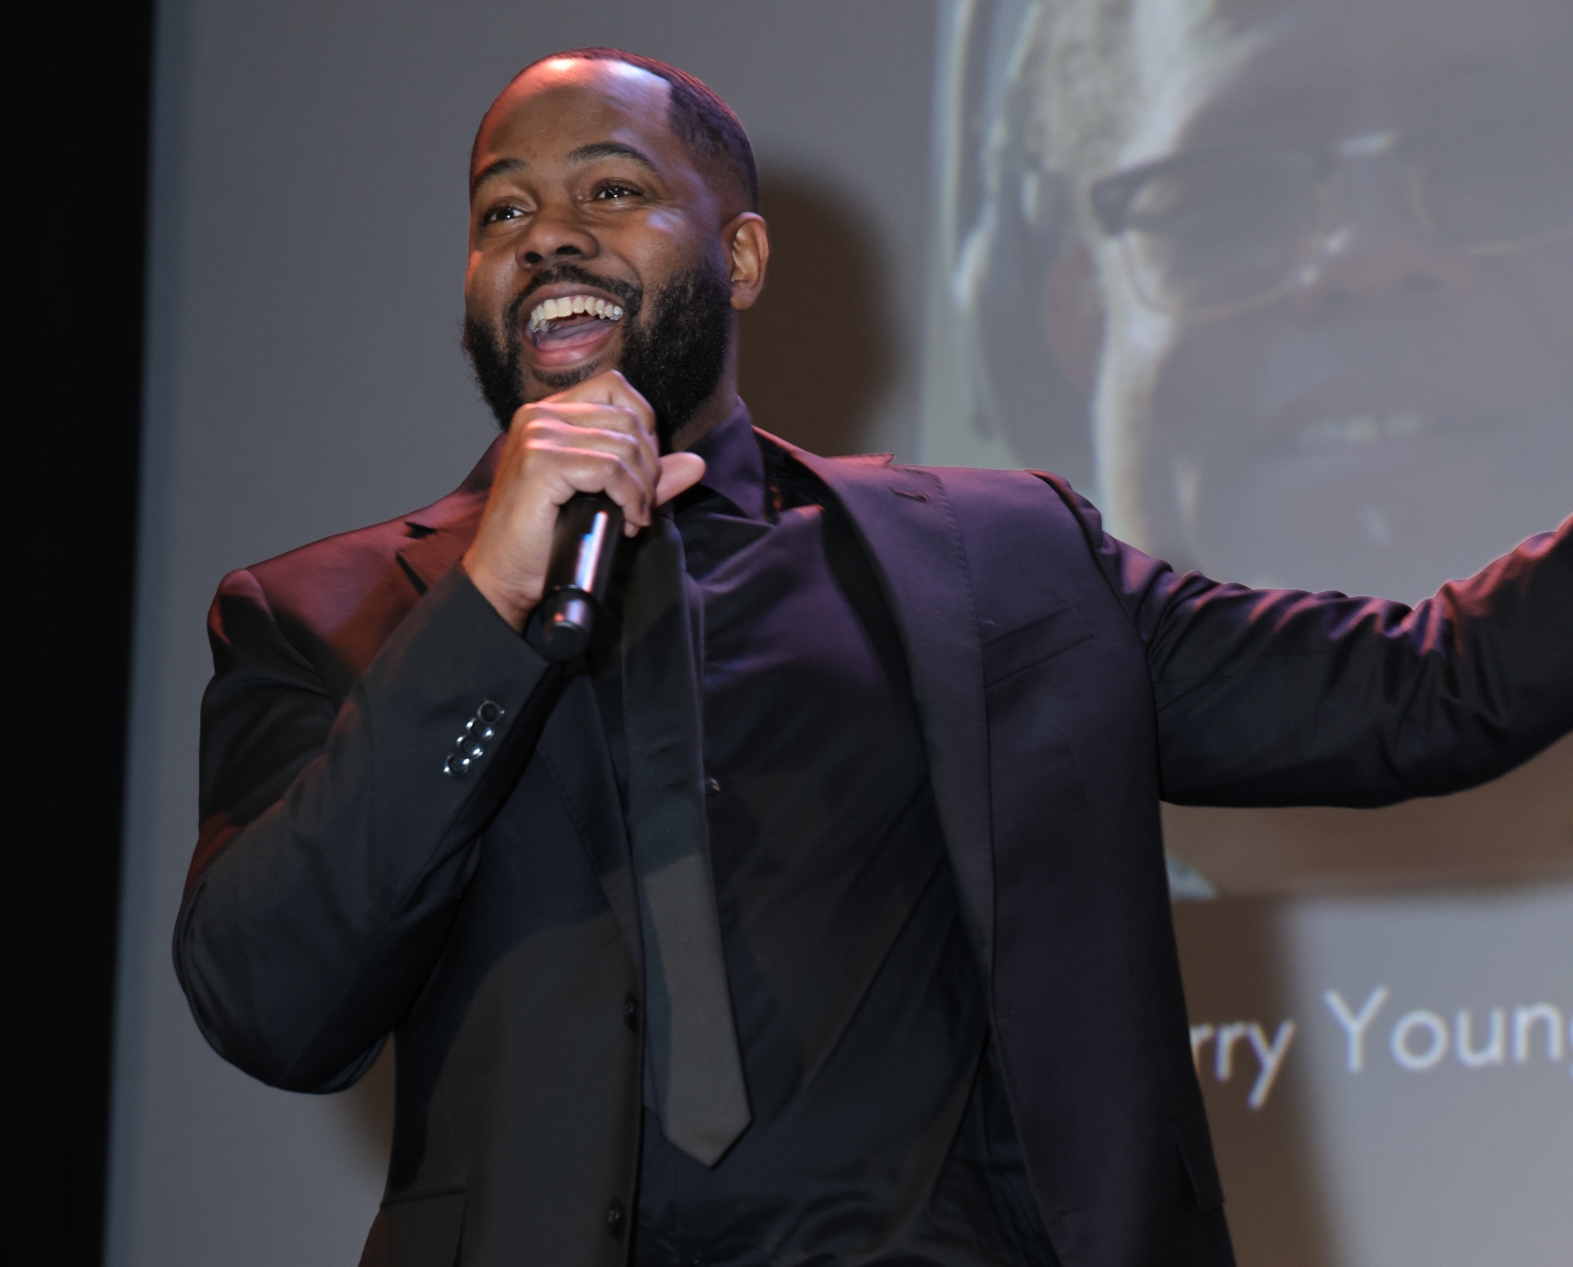

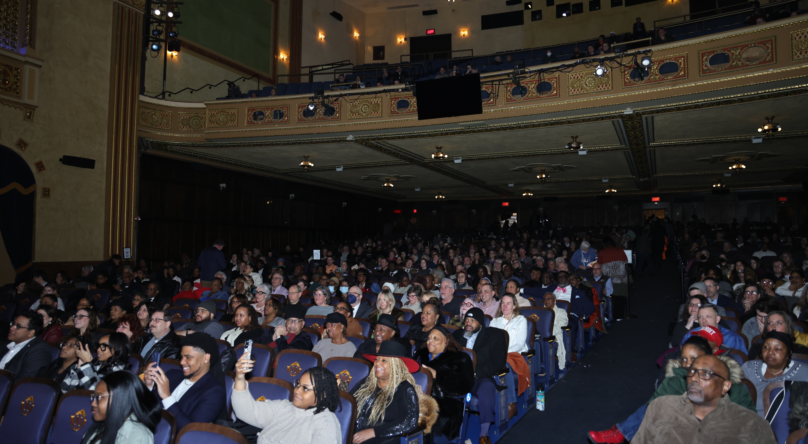
Documentary "A Letter to the West Side"

Slide 10





Mural Concepts
Notes:
Asha Jordan (signs and logos), Curtis Wallace (top - education), Dustin Hunt (bottom – community service), Gary Horton (alley - Home), Robin Speth (Porters Place Wall – creativity of the future), T’onna Clemons (6th floor social scene), Chadwick Smith (inside – familial gathering & John Onye Lockard and Dr. Albert Wheeler and Mrs. Emma Wheeler)

Slide 11
Affordable Housing Millage Guidelines
Adopted by City Council
July 27, 2020
Resident Services
Mental Health
Physical Health
Financial Services
Job Skills & Employment
Daily Living Skills
Crisis Management
Conflict Resolution
Youth Programming
Socio-Economic Diversity
All Neighborhoods
100% Affordable
Mixed-Income
Group Homes
Apartment Complexes
Inclusive & Equitable
Special Needs Seniors
Persons with a Disability
Youth Aging out of Foster Care
Homeless

Slide 12
Millage Guidelines Adopted by City Council
Sustainability
Energy Efficient
Green Construction
Net Zero
Development
New Construction
Acquisition
Demolition
Infrastructure
Utilities
Renovations
Permanent Affordability
Publicly-Owned Properties
Ann Arbor Housing Commission
Mission Driven Non-Profits
Cooperatives
Owner Models with Permanent Affordability
Leverage
Maximize Other Resources
Philanthropic
Public/Private

Slide 13
Project Financing

Slide 14
121 Catherine Funding Sources
Total Development Sources | $33,772,787
LIHTC Equity | $12,748,725
City of Ann Arbor Bond Financing | $9,000,000
HUD HOME (Washtenaw County) | $2,163,112
State MEDC RAP Grant | $4,018,915
Downtown Develop Authority | $650,000
City Housing Millage | $1,925,669
WCBRA Brownfield Funding | $959,406
State EGLE Brownfield Funding | $1,000,000
Federal Home Loan Bank | $458,872
IRA Geothermal Tax Credit | $254,975
General Partner Capital | $118,113
City of A2 Climate Millage | $475,000

Slide 15
Dunbar Tower Additional Funding Support
Predevelopment/Bridge Funding
  Ann Arbor Affordable Housing Millage
Construction loan
  Comerica Bank (Fifth Third)
  Chelsea State Bank
Project-Based Vouchers
  Ann Arbor Housing Commission
Payment in Lieu of Taxes (PILOT)
  City of Ann Arbor
Services Funding
  City of Ann Arbor Affordable Housing Millage

Slide 16

Putting People First
Avalon Housing believes that the most essential need for people and families experiencing homelessness is immediate, safe and permanent housing.
From there we can meet all other challenges together.

Slide 17

Support Services
Mental Health and Chronic Disease Management
  Full spectrum primary care services at co-located clinics in partnership with Packard Health
Substance Use and Recovery Services
  Avalon support specialists are trained in motivational interviewing and harm reduction
Older Adult Services
  Older Adult Specialists and Home Health Aides provide hands-on assistance for older (55+) residents
Youth and Family Services
  Family-based services to heads of households to liaison with local schools and governmental systems
Food Assistance
  Avalon provides weekly food pantries at six locations in partnership with Food Gatherers

Slide 18
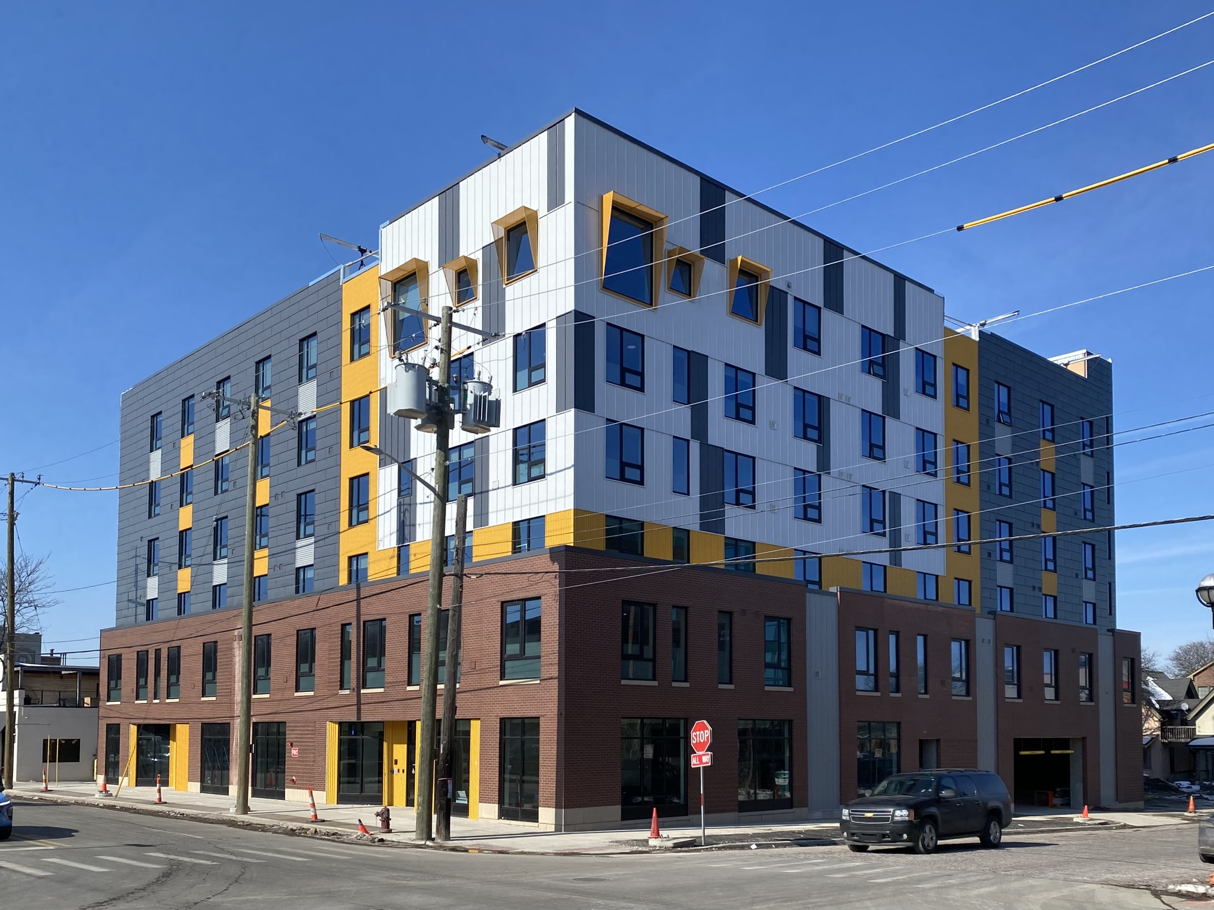
Dunbar Tower – Artist Preference
31 one-bedroom apartments for $650–$900 per month
Preference for artists and creatives (does not have to be source of income)
Includes an Artist Interview Committee process
Preference for Washtenaw County residents and/or workers
At least $1,950 to $2,700 monthly income ($23,400 - $32,400/household per year)
Annual income cannot exceed $52,920 for 1 person, or $60,480 for 2 persons
Tenant-based rental vouchers can be used for these apartments

Slide 19
Building Design

Slide 20
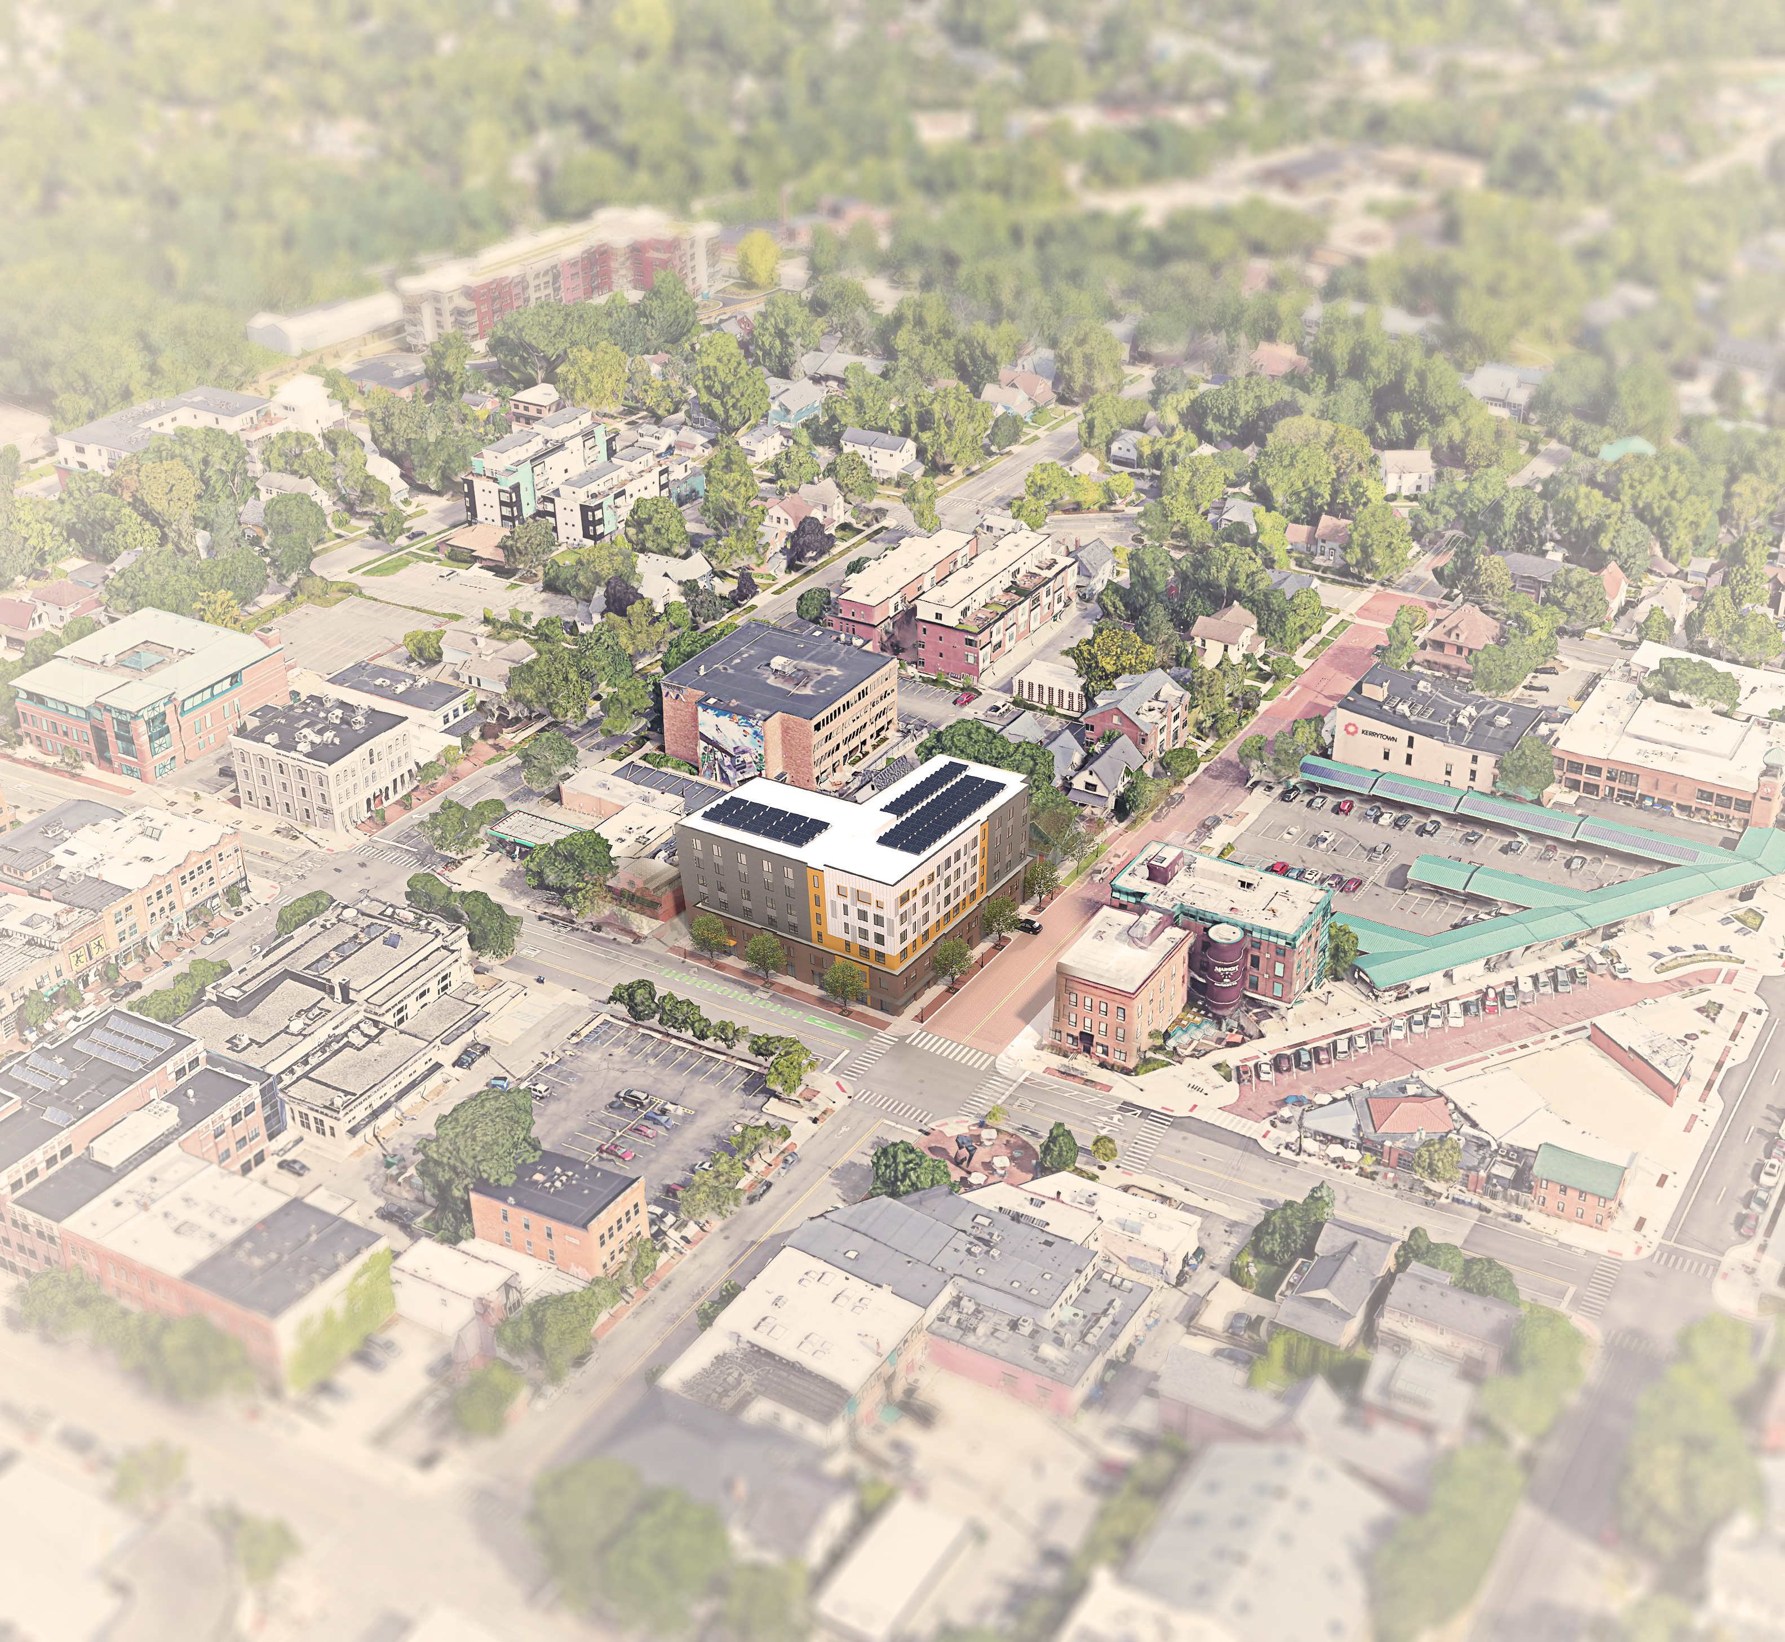
Site & Building Information
Zoning District:
D2
Occupancy:
R-2, B
Construction Type:
Type IA (Podium)
Type IIA (Levels 2-6)
Lot area:
16,698 SF
Gross Building Area: 66,828 GSF
Height:
6 stories, 63’-9”
Units:
63
(62) 1-BR
(1) 2-BR
Parking:
16 parking spaces
23 bike spots

Slide 21
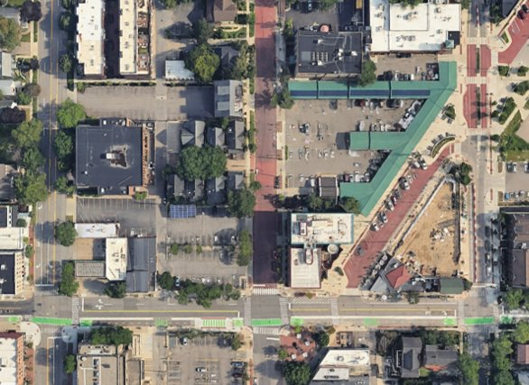
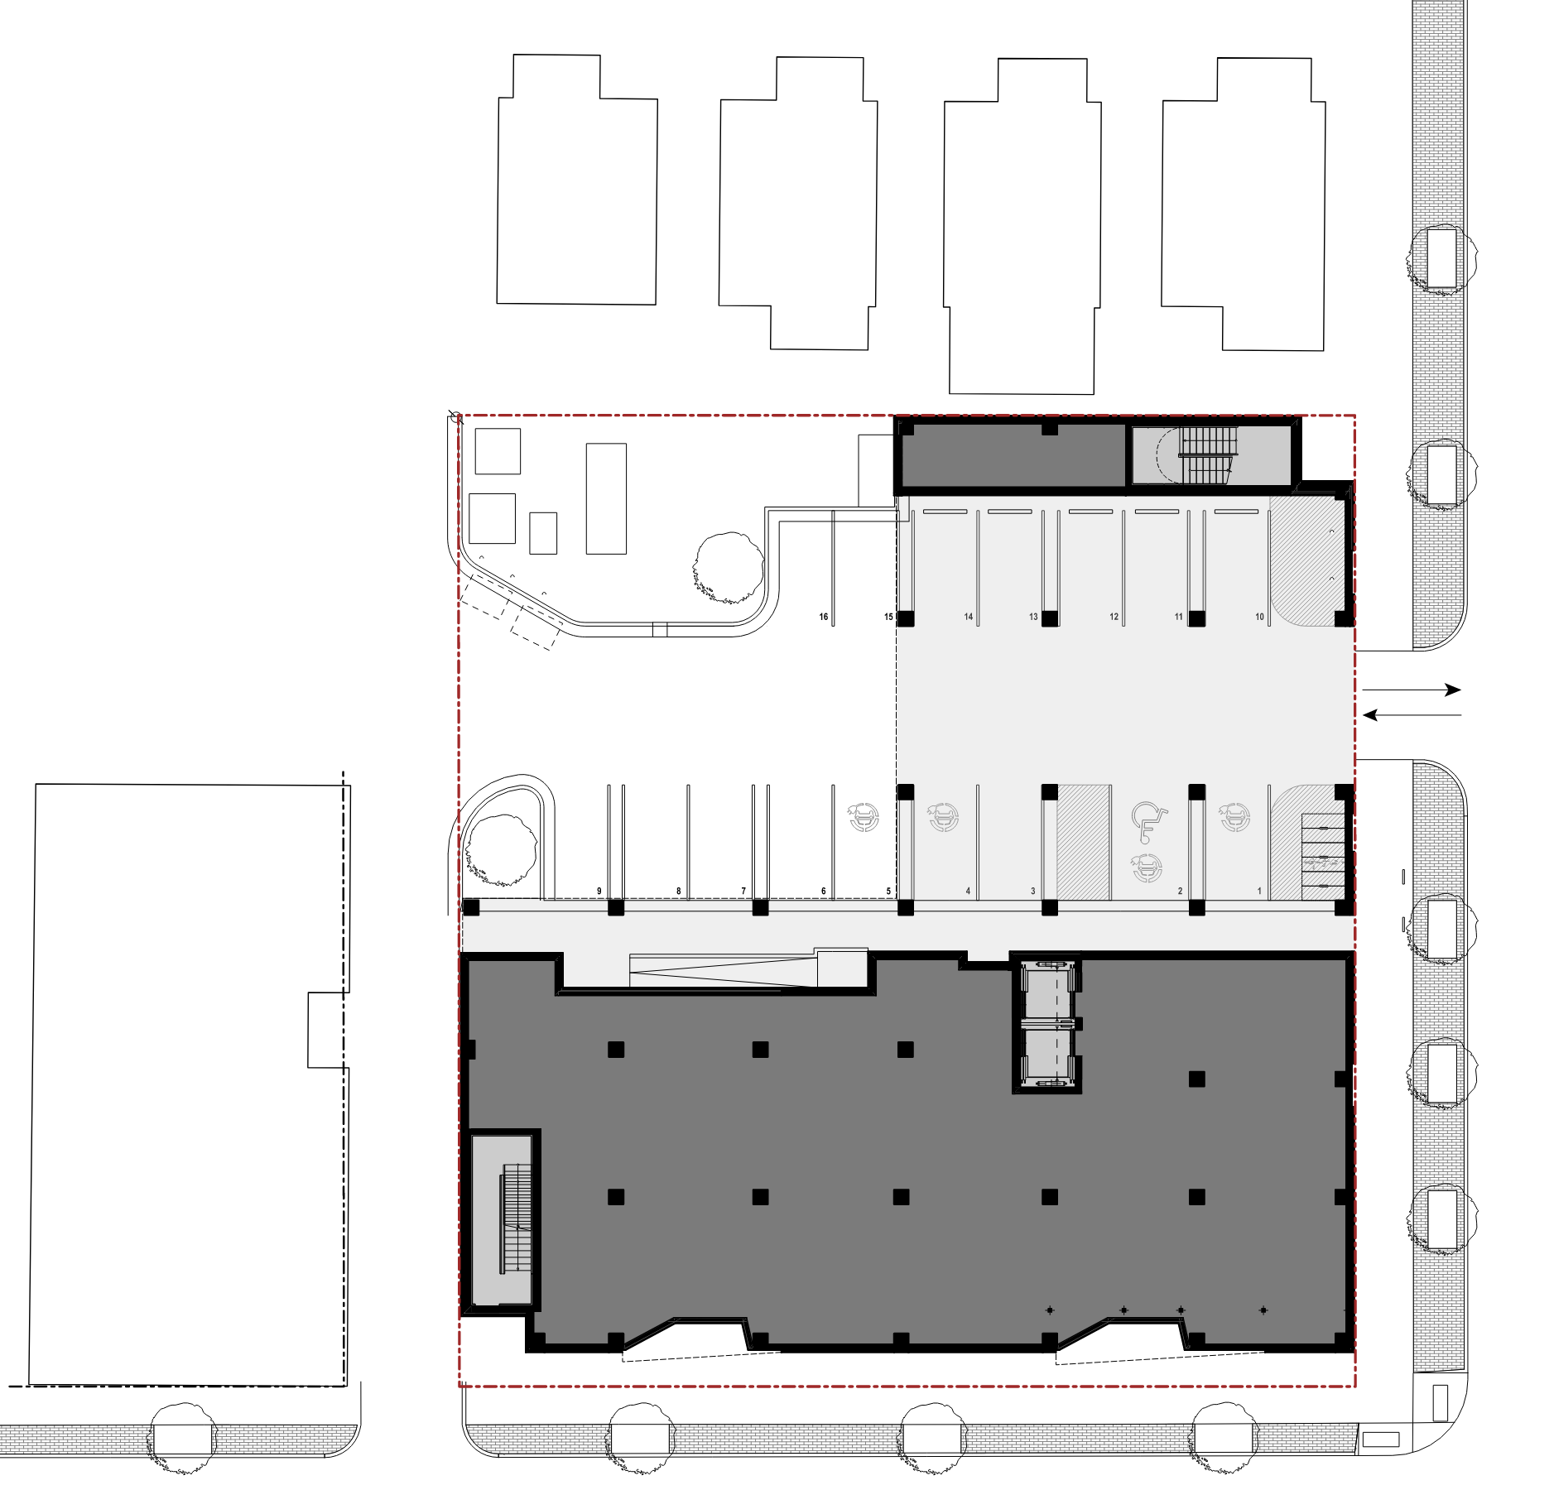
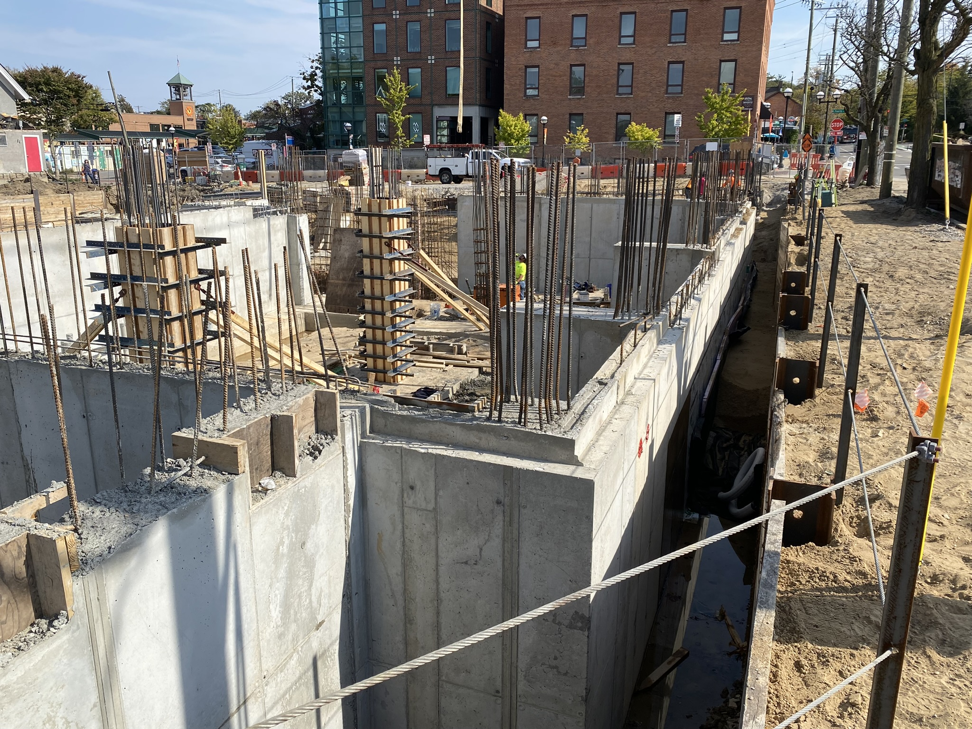
Site Constraints
Site Constraints
124'-2"
PROPERTY LINE
4TH AVE
134'-7"
ALLEY
CATHERINE ST

Slide 22
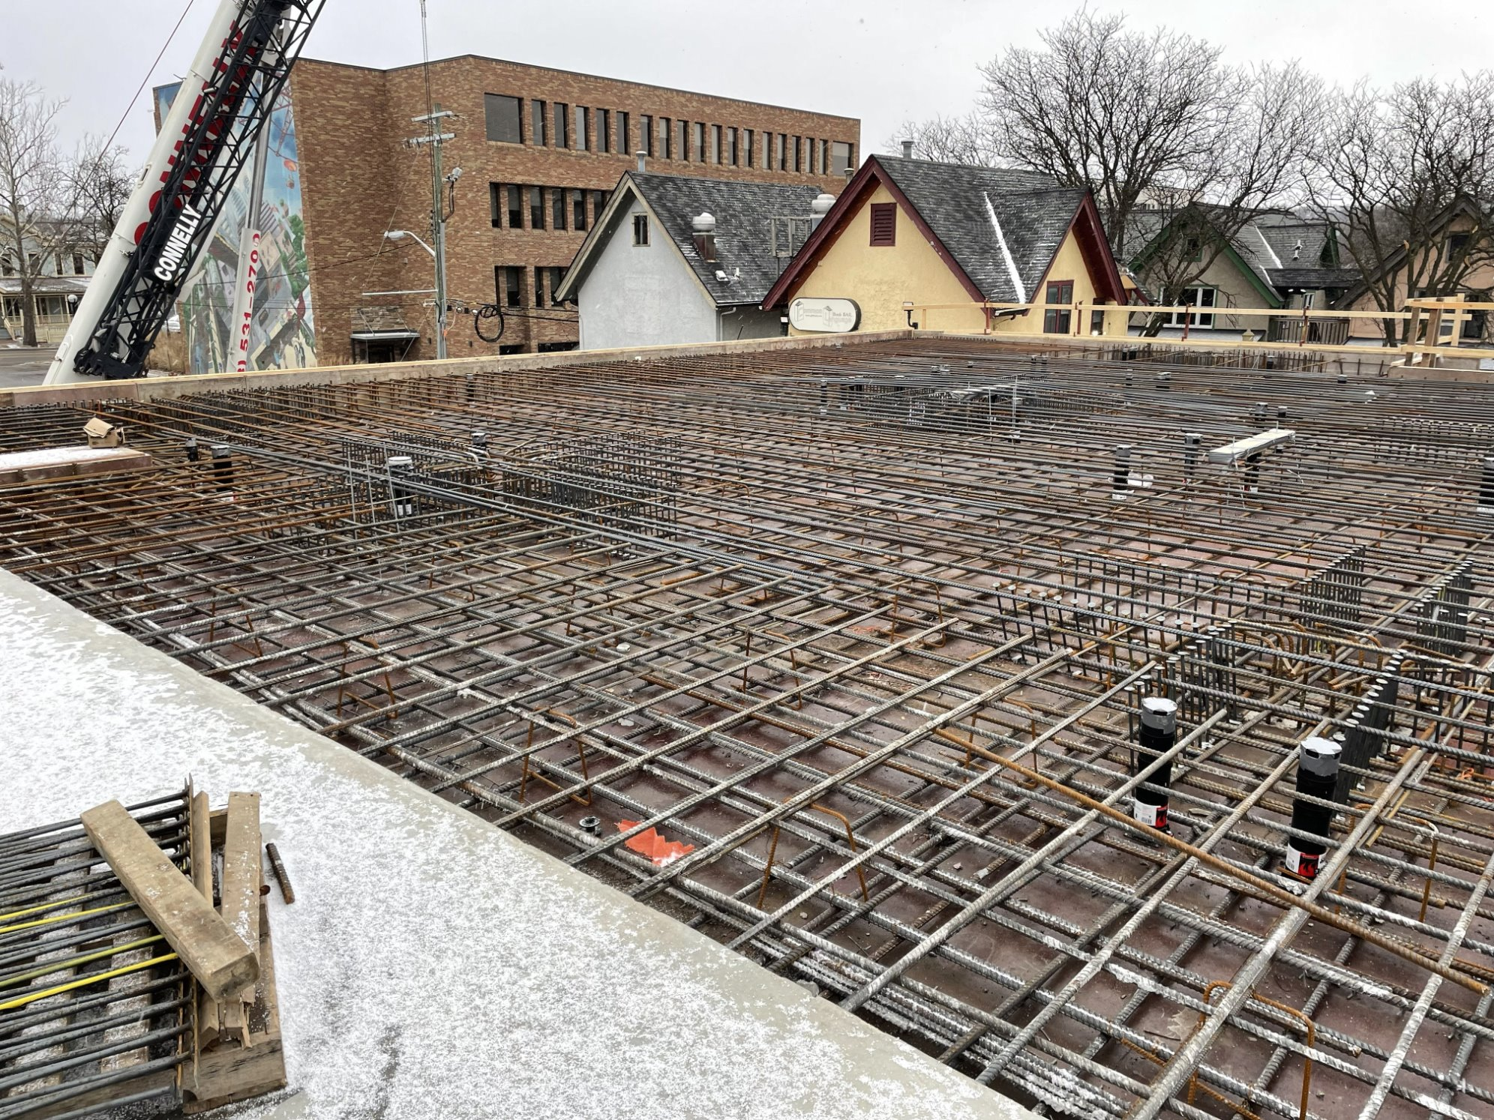
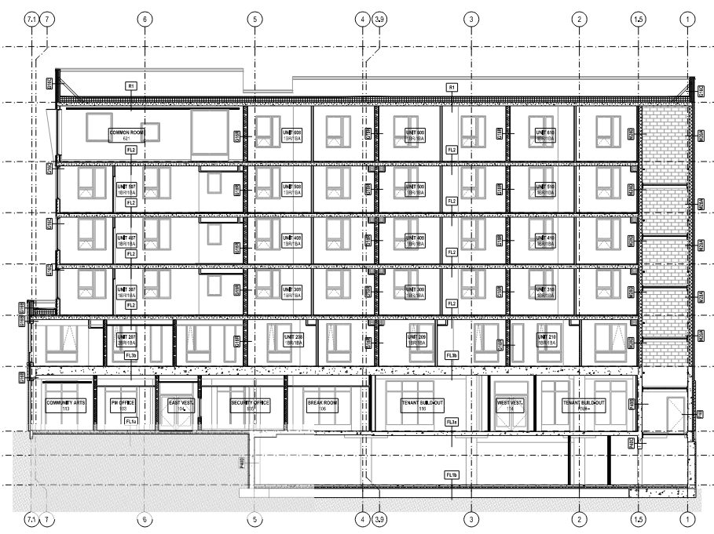
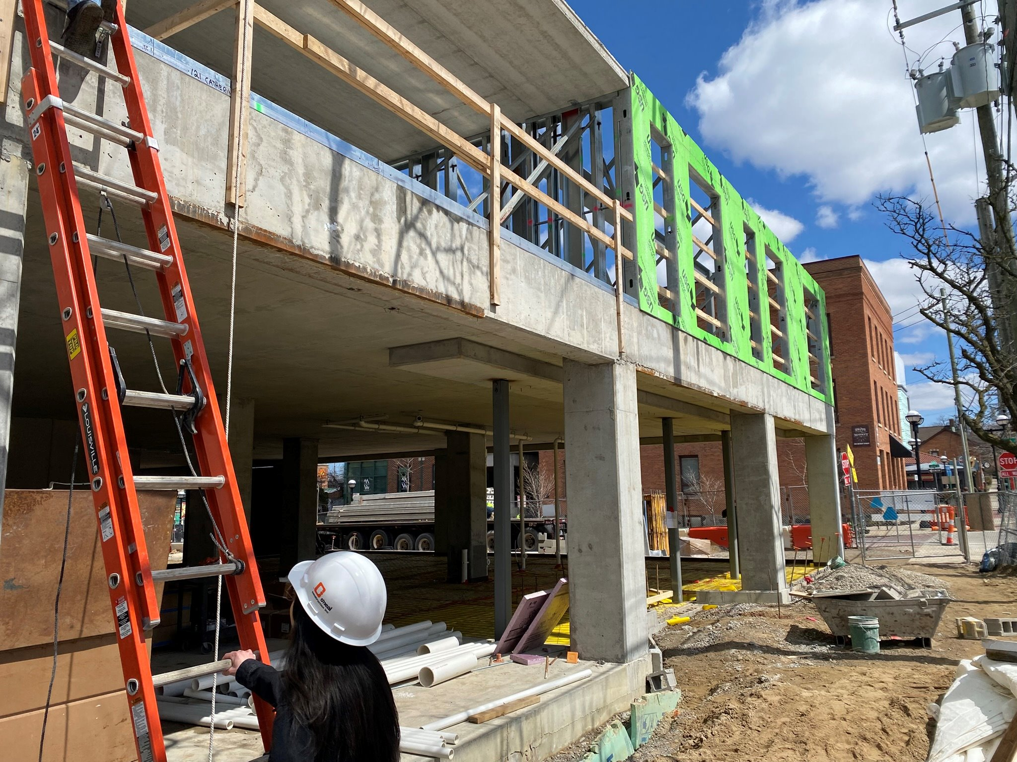
Building Structure
6 stories / 63'-9"
Cast-in-place podium (I-A) with steel stud and precast planks above (II-A)
Cast-in-place concrete
CMU
Cold form bearing walls
Precast planks
Precast Concrete Plank Floors
+
Load Bearing Cold Form Stud Walls
TYPE IIA
Cast-in-Place Concrete Podium
TYPE IA

Slide 23
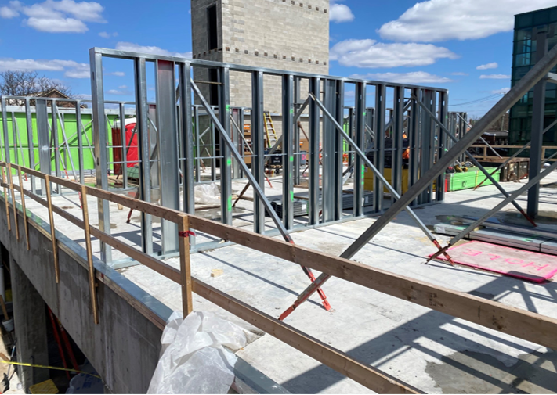
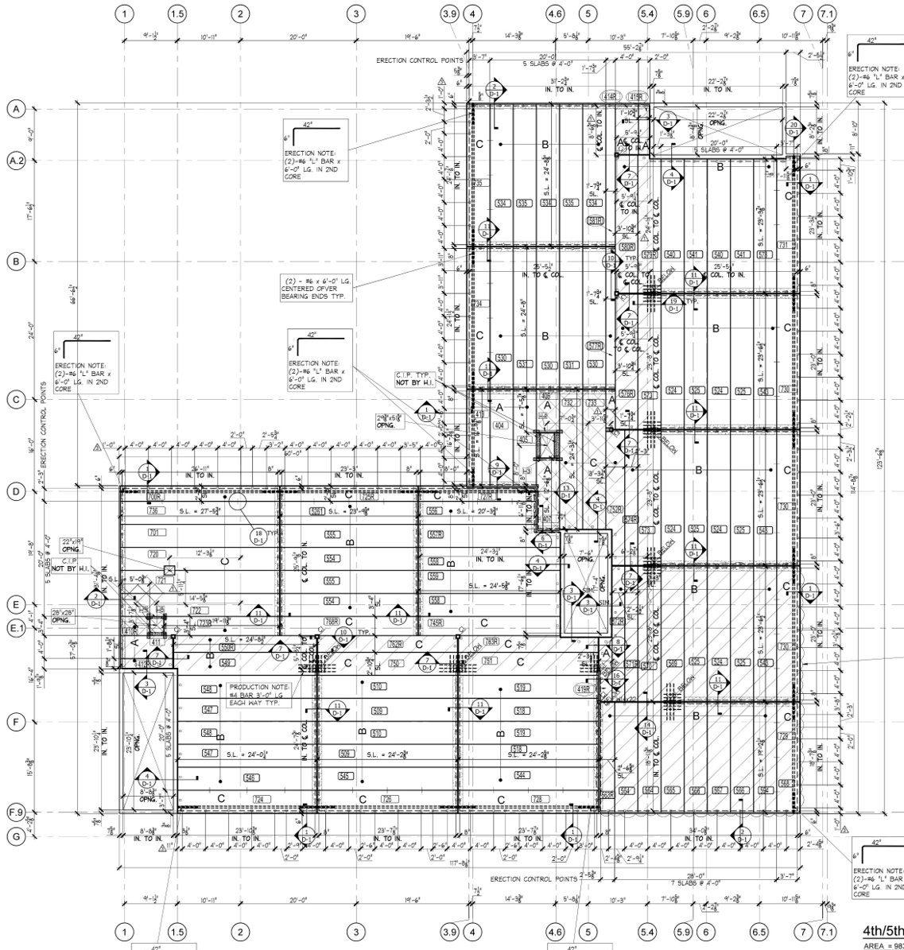
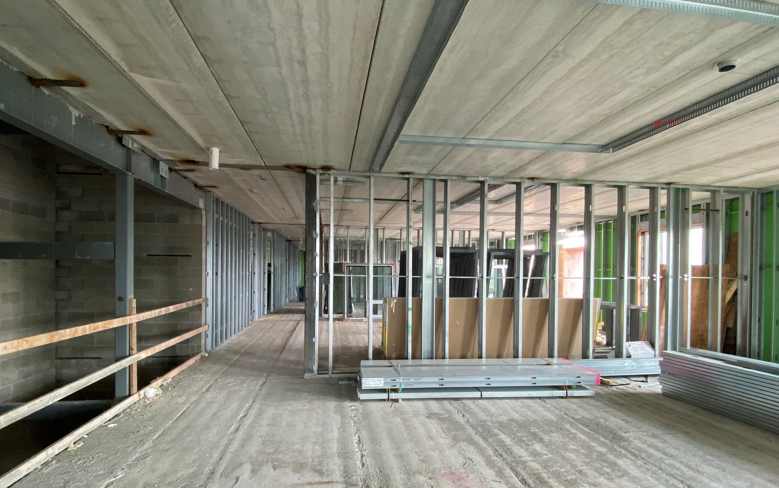
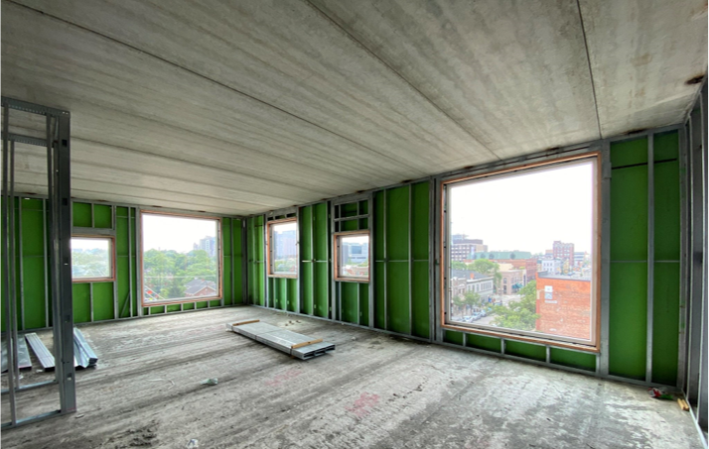
Building Structure
Cold form bearing walls
CMU
Precast planks - direction

Slide 24
Basement Plan
Notes:
Fix name

Slide 25
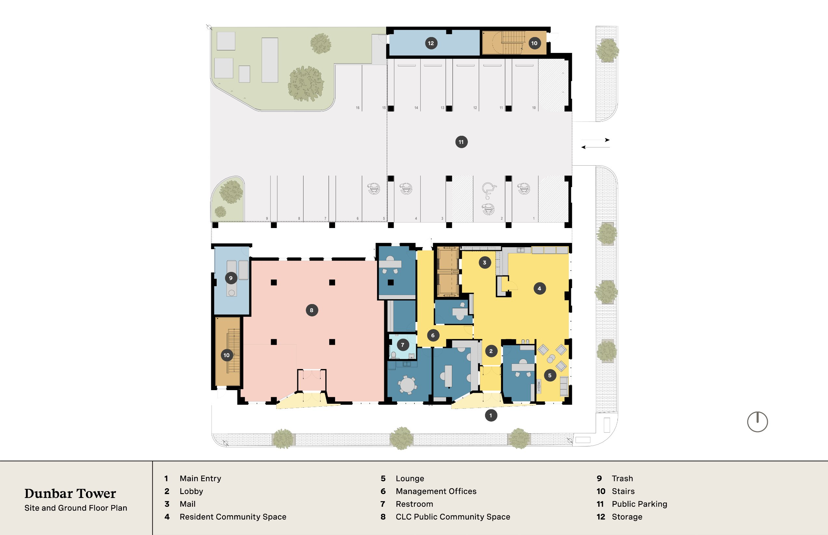
Site and Ground Floor Plan
4TH AVE
CATHERINE ST
Notes:
Fix name

Slide 26
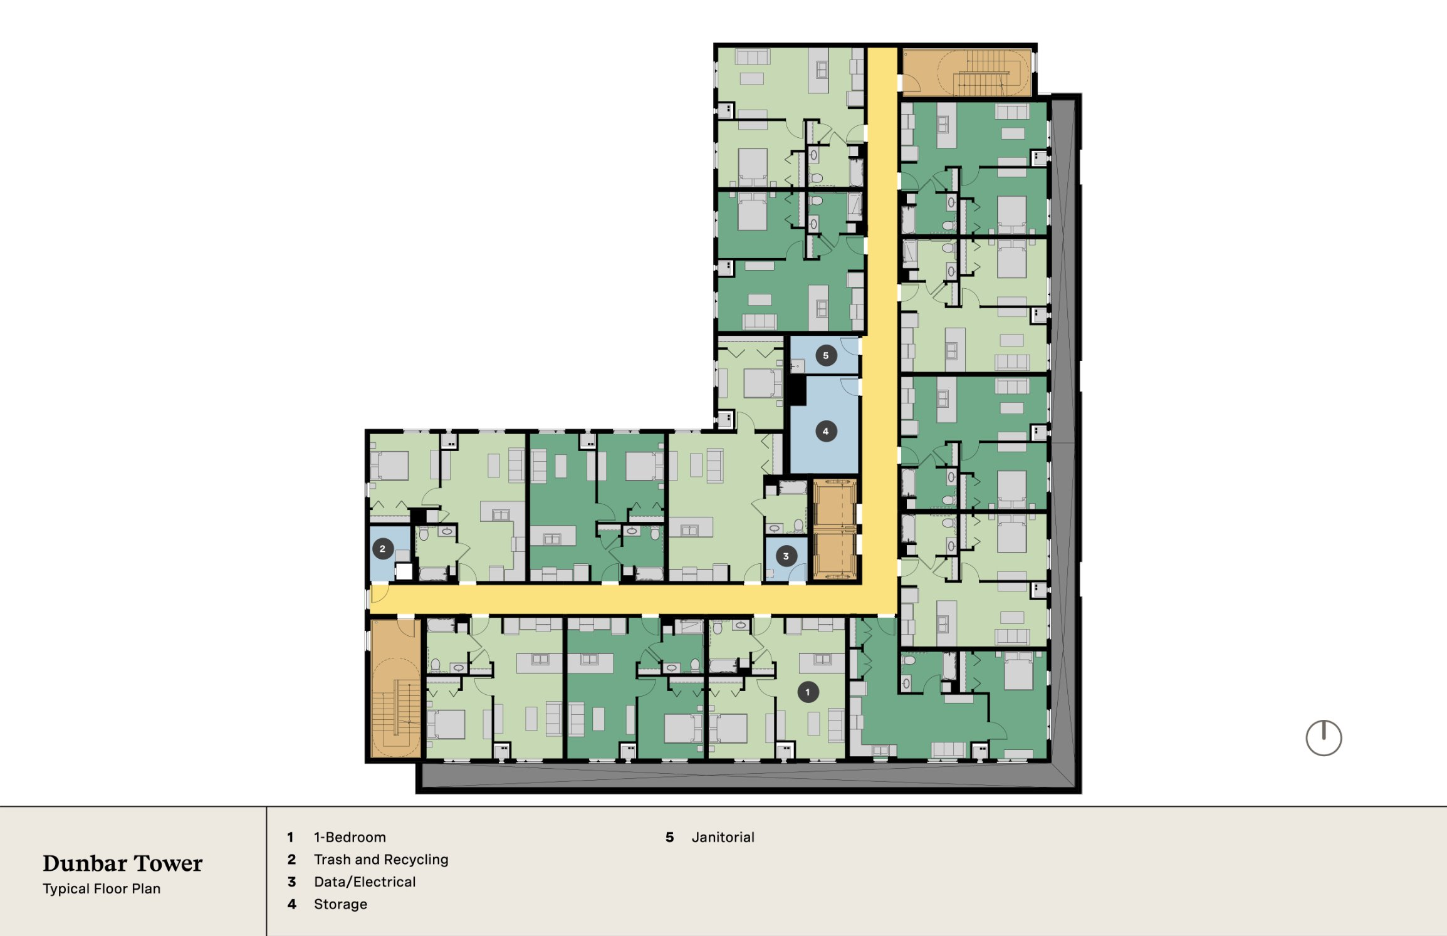
Typical Floor Plan
Notes:
Fix name

Slide 27
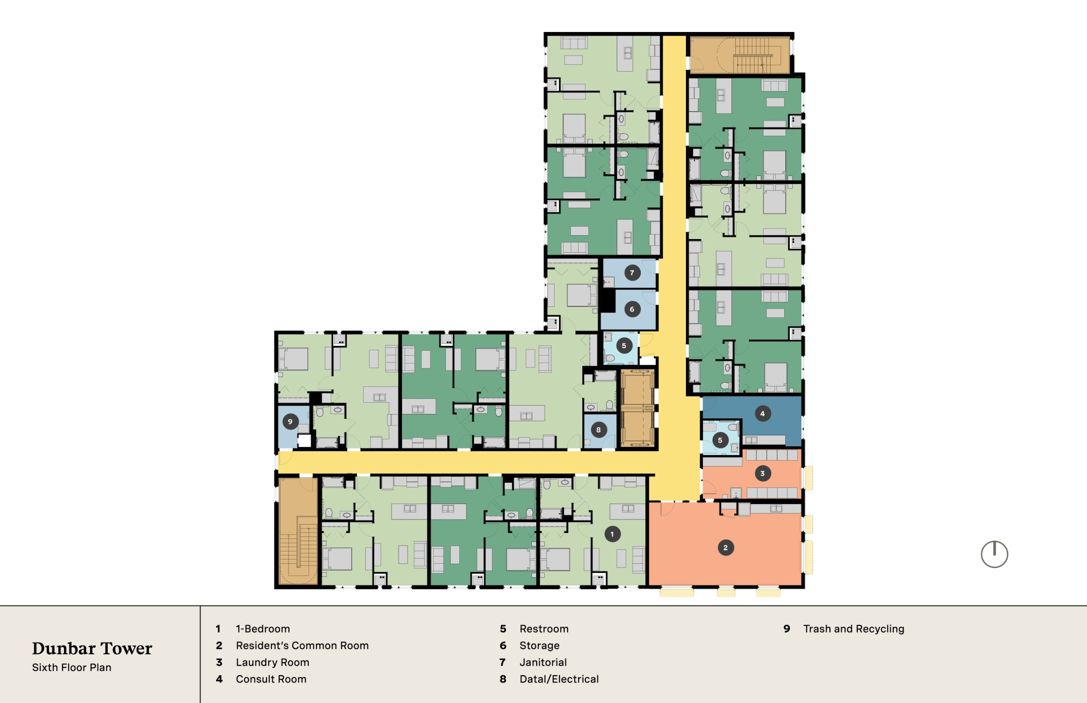
6th Floor Plan
Notes:
Fix name

Slide 28
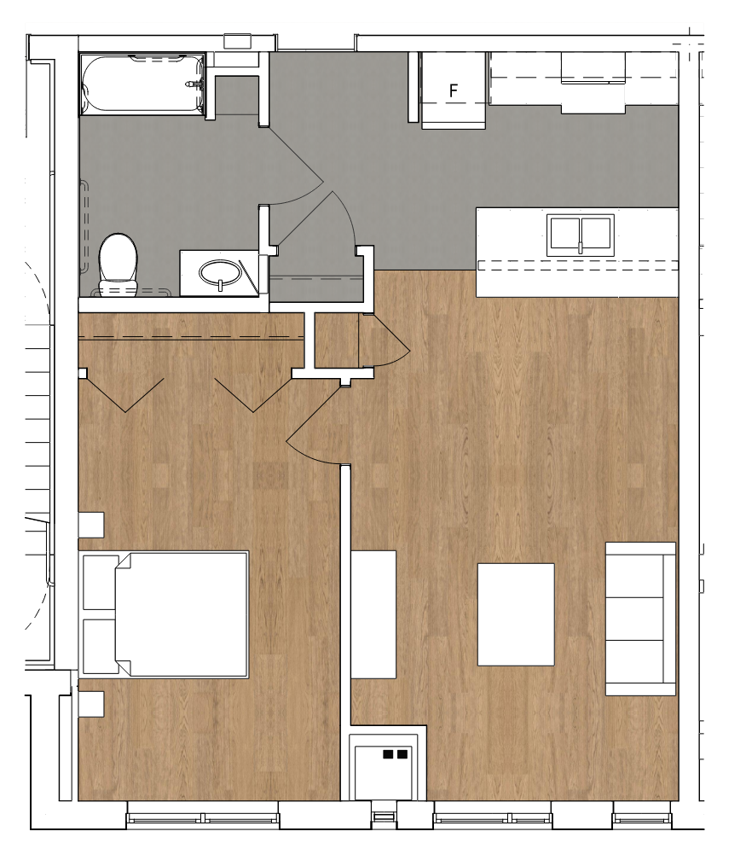
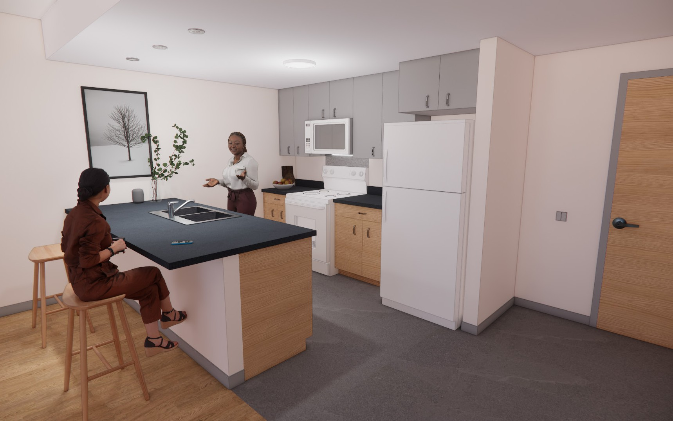
Typical Unit Plan – 1-Bedroom
630 sq ft
Notes:
Fix name

Slide 29
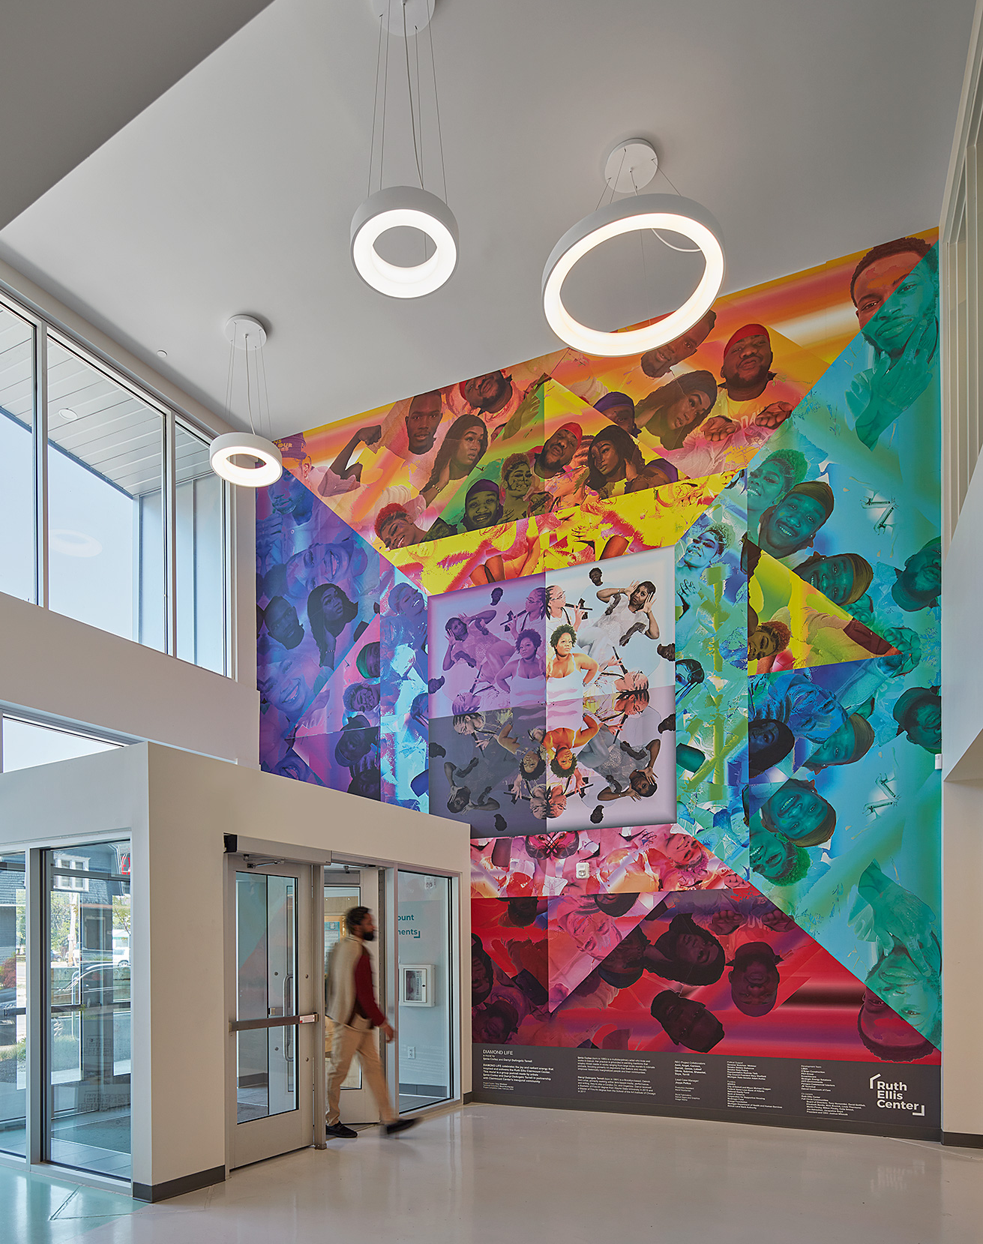

Inclusive and Trauma Informed Design
Why Does Space Matter?
Our first relationship is with the physical environment- our bodies have an immediate response to the space we occupy.
Design/Architecture can heighten or calm the body’s response to stressors by modulating environment stimuli and atmosphere.
If this relationship is considerate and safe, it can be healing.
Design/Architecture can be the first point of contact to cultivate peace of mind and connection.
“The three C’s”
  Choice—agency and ownership of your personal space and the ability to choose between private space and communal gathering.
  Community—orientation and design of public space to promote relationship building between staff, residents, and guests.
  Comfort—quality and variety of material—sensory experiences of light, sound, and smell—nature and artwork to spark joy and healing.

Slide 30
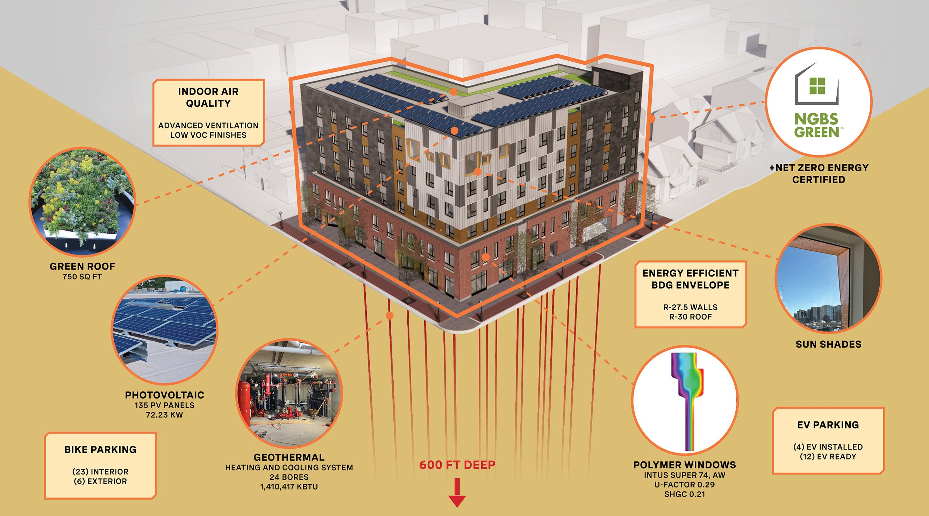
Sustainability

Slide 31
Geothermal Design
Notes:
More photos

Slide 32
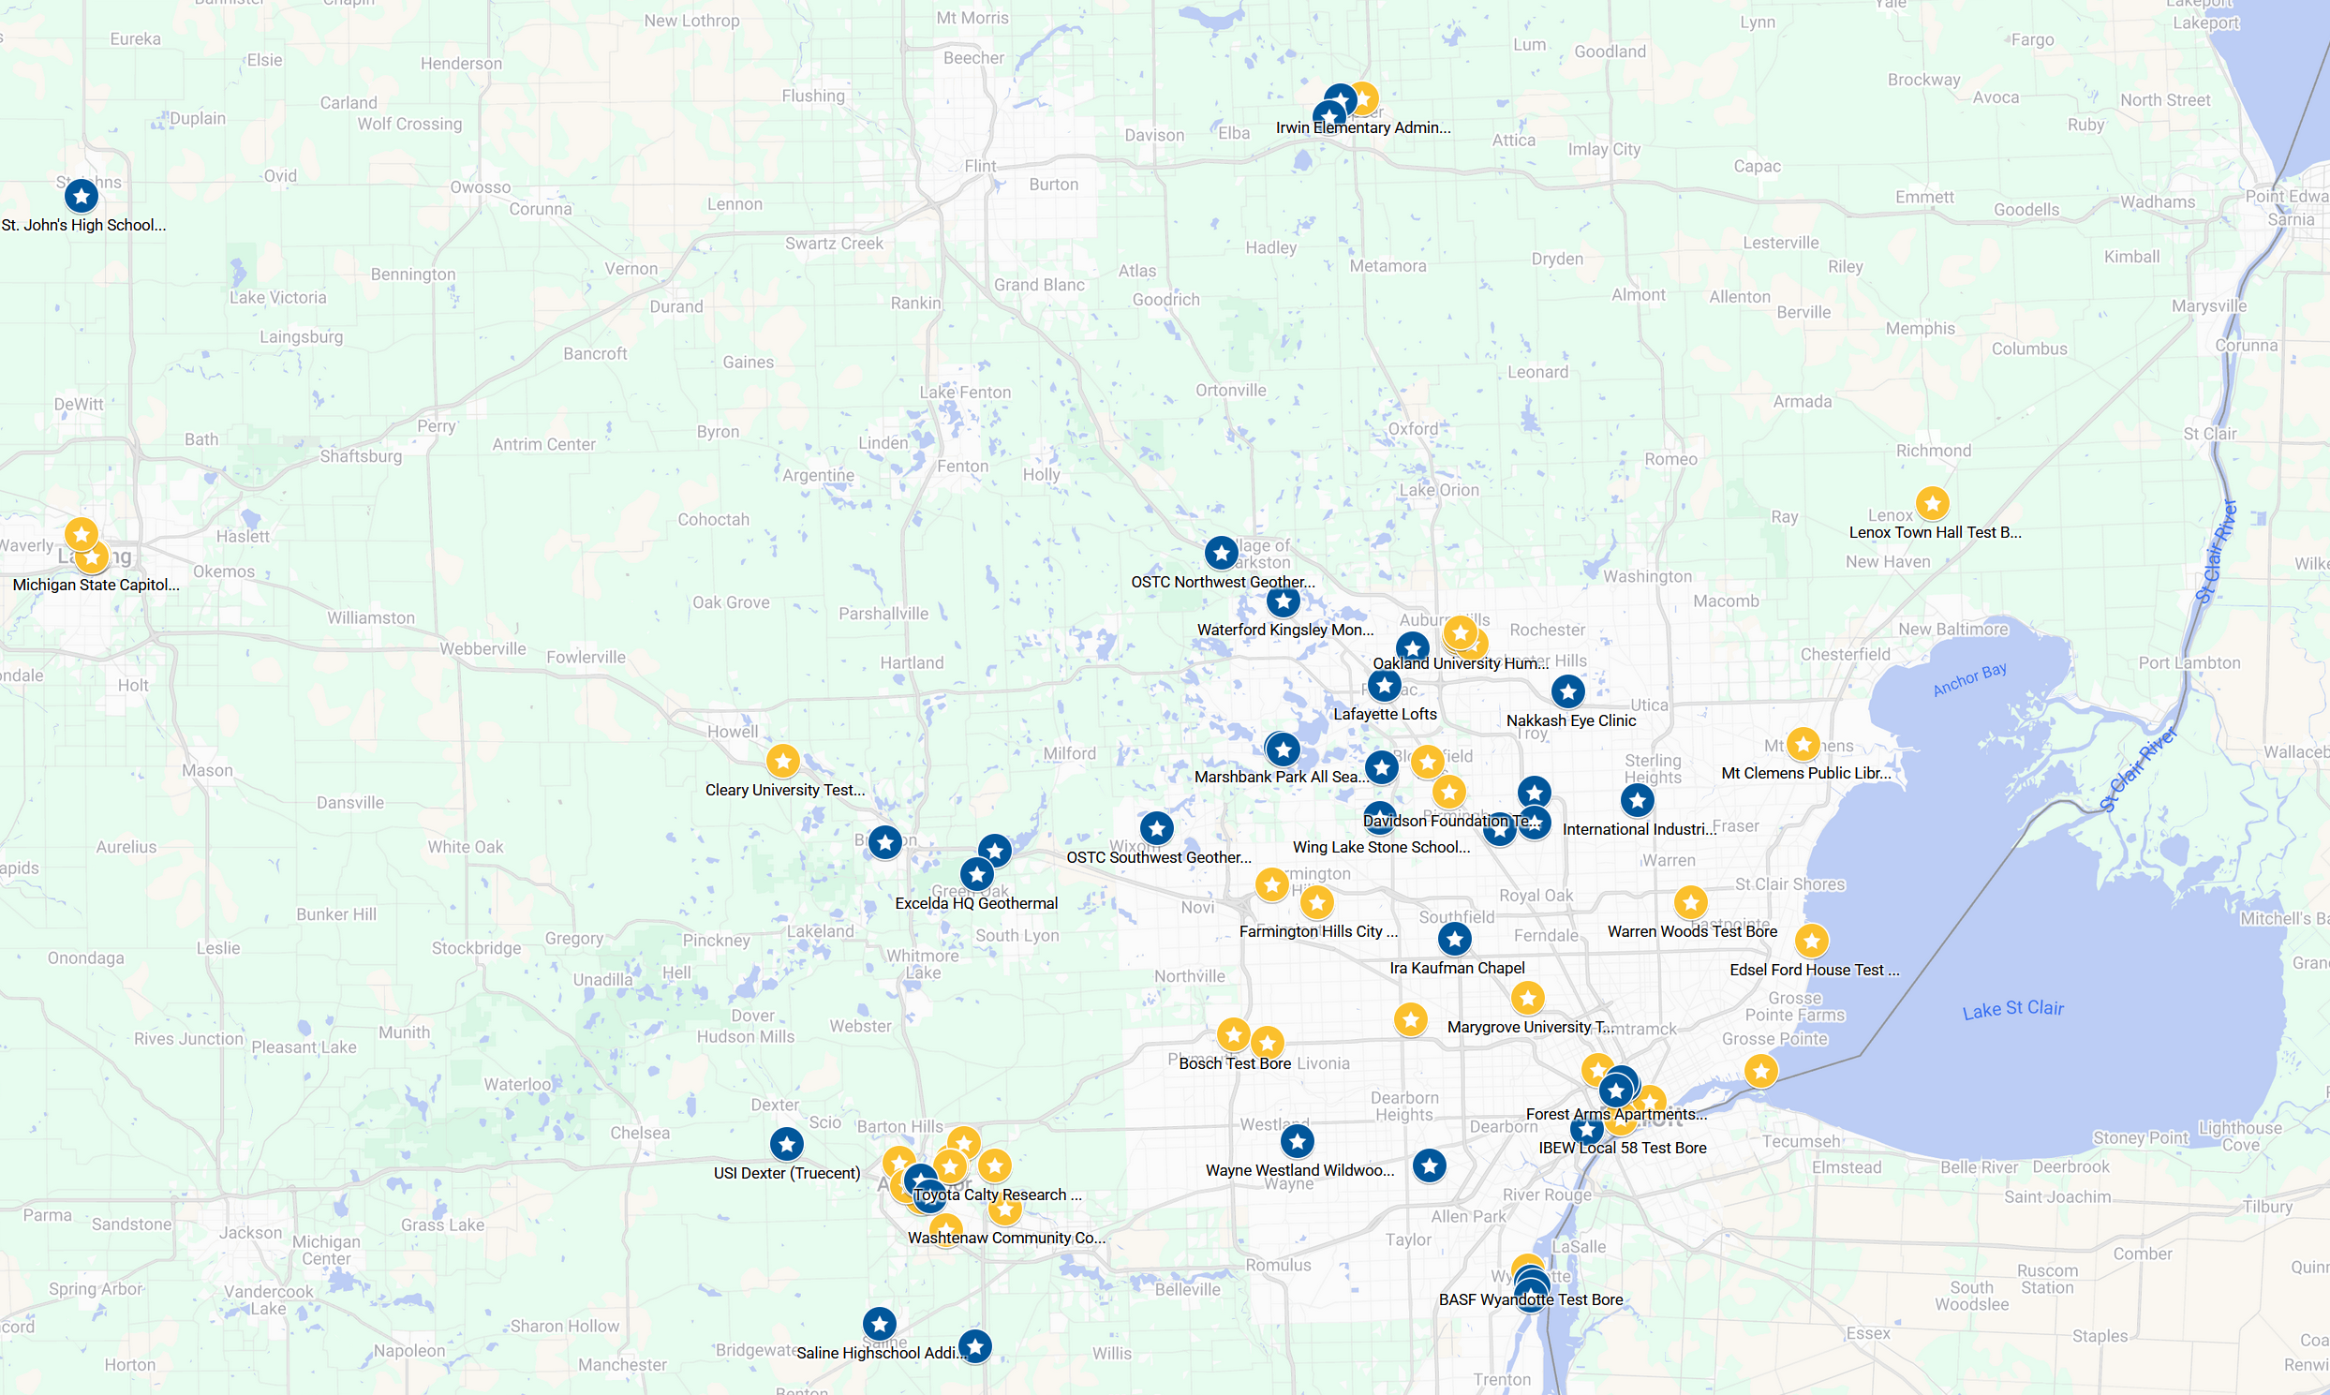
SE Michigan Geothermal Experience
Steve DiBerardine, PE, CGD
Strategic Energy Solutions
28 Years Geothermal Experience
Canfield Lofts in Detroit – 1998
Certified Geothermal Designers
Certified Geothermal Installer
Certified Geothermal Inspector
136 geothermal projects​
37 Installs​
55 Formation Thermal Conductivity Tests
Notes:
More photos or info

Slide 33
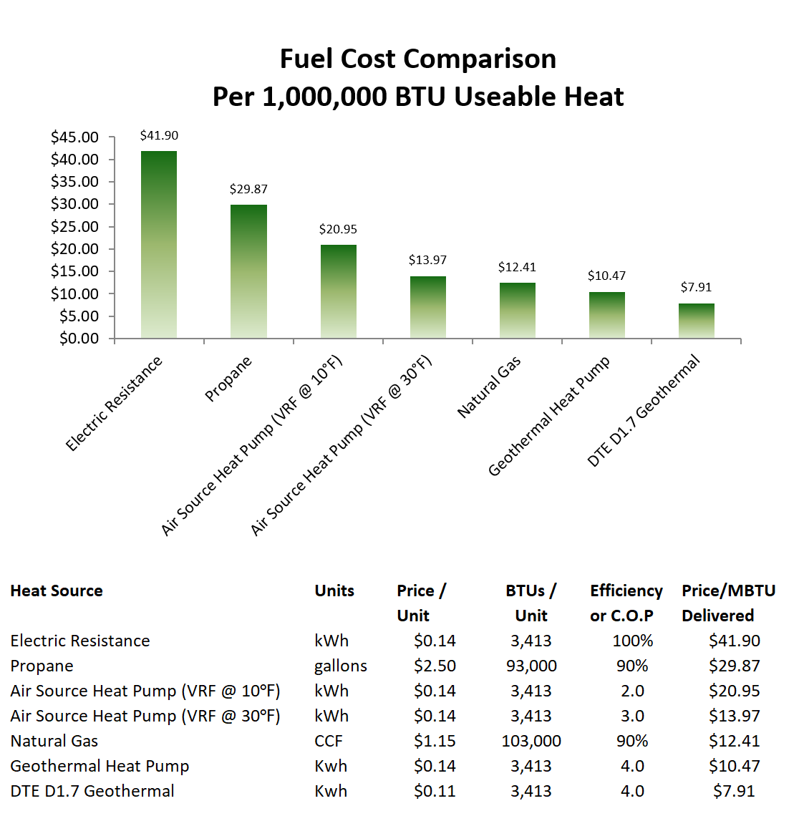
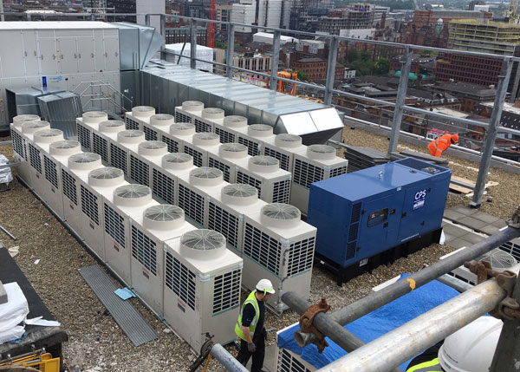
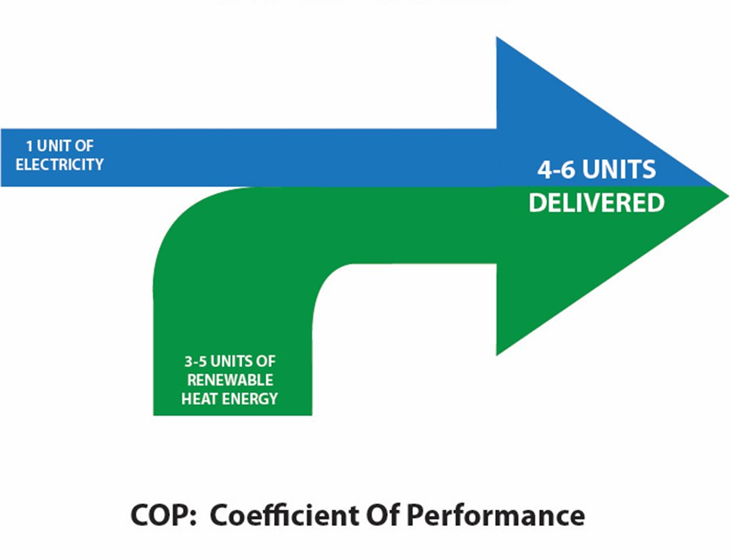
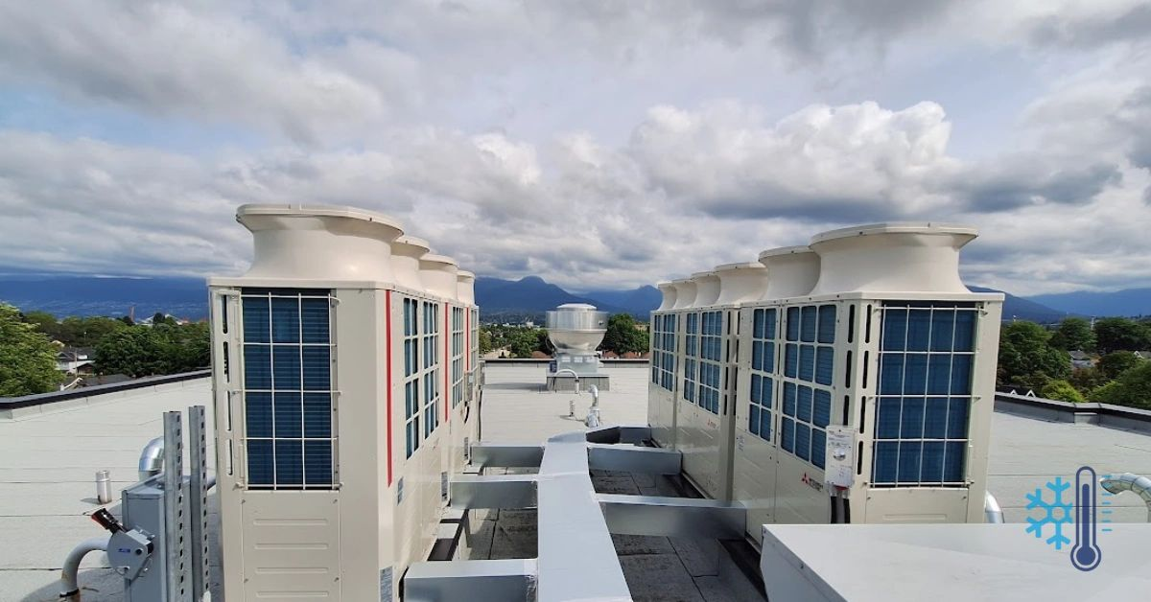
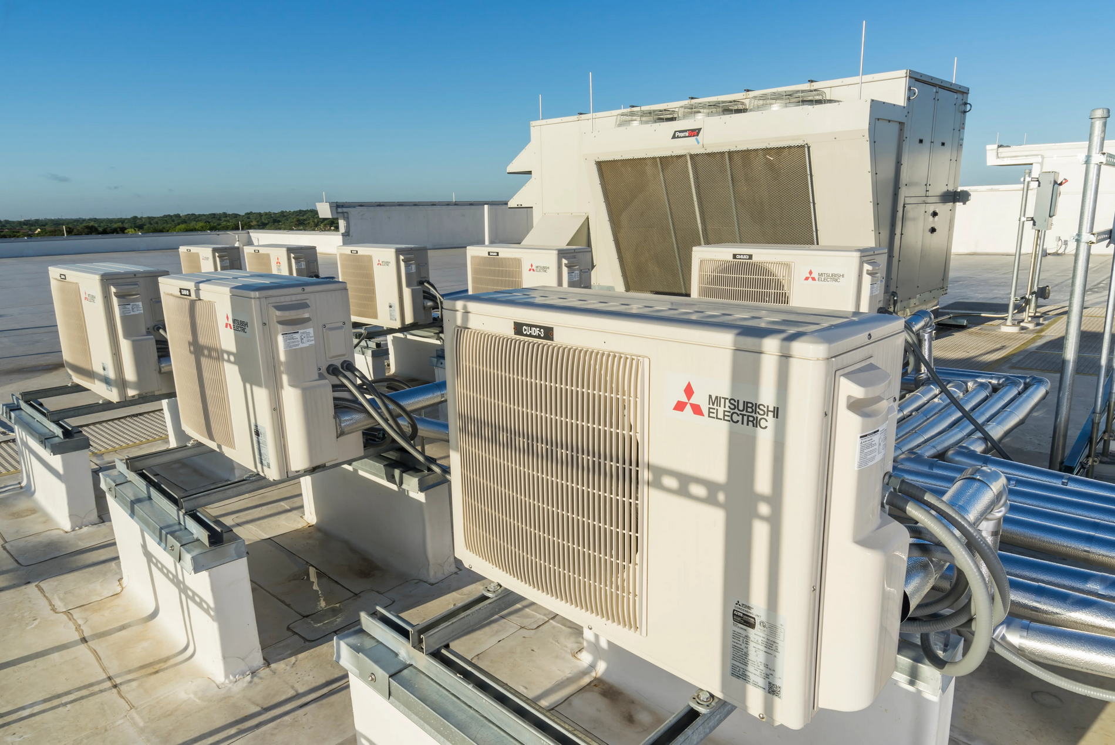
Electrification Options: Electric Resistance vs GSHP vs ASHP
Notes:
More photos or info

Slide 34
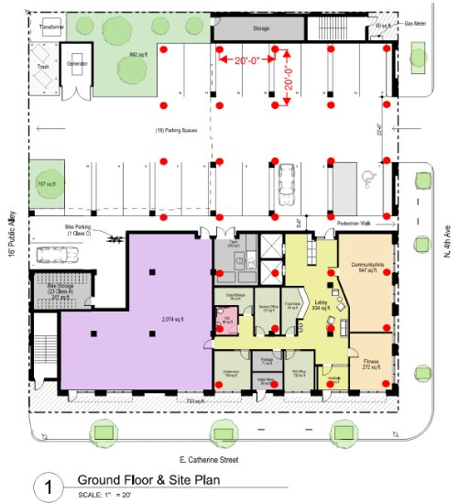

Prefeasibility Phase – Estimate Loads & Plot Dots​
There are no rules of thumb for geothermal design. There is, however, a place for them in prefeasibility.
Estimate Peak Diversified Load (sq. ft. per ton)
Estimate Bore Requirements (lf bore per ton)
Assume Bore Dept (ft)
Arrive at Bore Count Estimate
Cooling loads determine field size on most commercial projects in S.E. Michigan and beyond.
Notes:
More photos or info

Slide 35
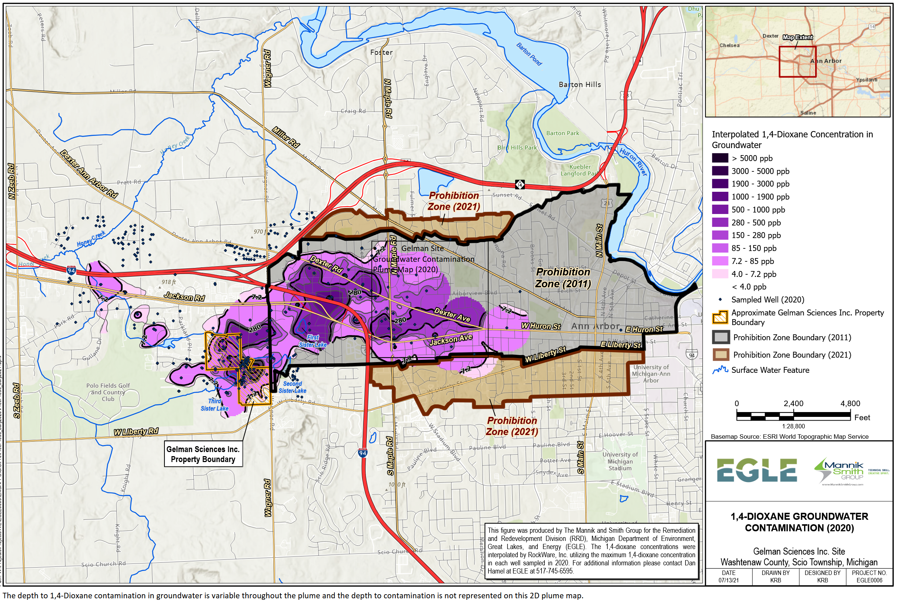
Gelman Plume – Groundwater Contamination​
Health Department Approval Case by Case
Jennifer Conn, PE, REHS
Washtenaw County Health Department
734-222-3855
connj@washtenaw.org
On this site a sample well was required.
The aquifers tested clean.
Provided a data point for future projects.
In zone – may need to case top of well
East of 121 Catherine ok for a few years
West of 121 Catherine may require sampling of aquifers
Notes:
More photos or info

Slide 36
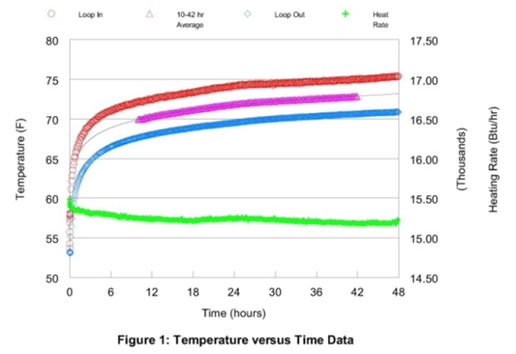
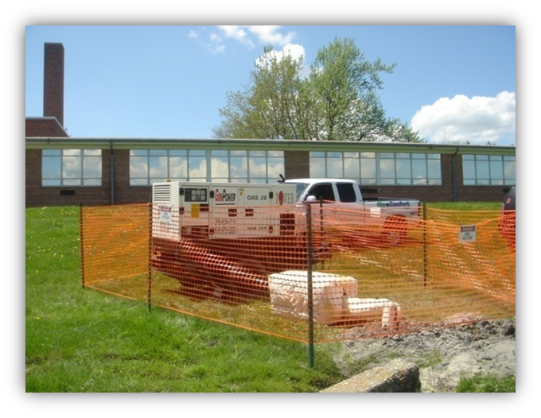
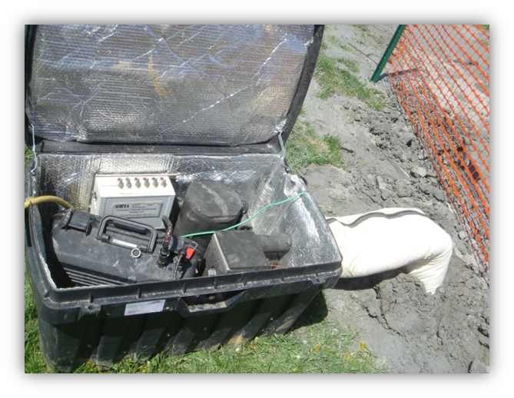
Formation Thermal Conductivity (FTC)Testing
Testing is typically done prior to final design and bidding of the geothermal work. The test results yield information on drilling conditions, deep earth temperature, and thermal conductivity. Contractors can bid drilling work with less risk. Engineers can design more accurately.
Notes:
More photos or info

Slide 37
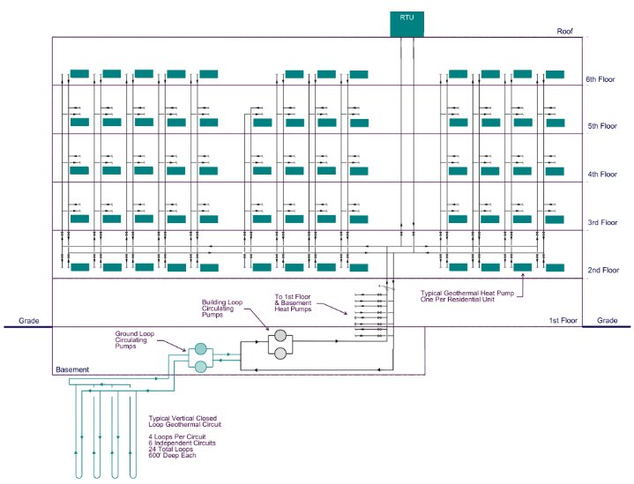
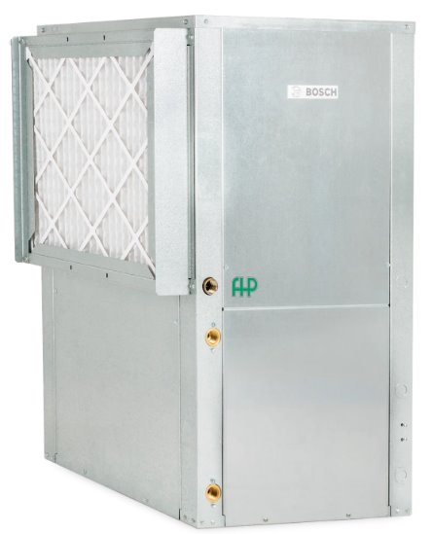
Geothermal System Schematic Diagram
Supply Air
Return Air
Geo
Piping
Connections
Geothermal Heat Pump
Notes:
More photos or info

Slide 38
How it Works: Cooling
90 F
55 F
Ground Loop
Refrigeration
Cycle
Air Coil
heat
heat
98 F
75 F
Works on same principle as any other air conditioner or refrigerator
Heat is rejected to the water loop instead of ambient – water cooled
Higher efficiency, longer compressor life
Notes:
More photos or info

Slide 39
How it Works: Heating
32 F
95 F
Ground Loop
Refrigeration
Cycle
Air Coil
heat
heat
26 F
69 F
Works on same principle as any refrigerator or air conditioner in reverse
The 32 degree water is cooled thus removing heat
Heat is rejected to the supply air
Just like a water pump can make water go uphill, a heat pump can make heat go from a low temp to a higher temp
Notes:
More photos or info

Slide 40



8,760 Hour Annual Energy Simulation Required For Design​
GHX = Ground Heat Exchanger
Acts like a battery that gets charged and discharged daily and seasonally.
Calculate peak loads as well as total energy loads.
Heating pulls about 75% of heat from the earth due to refrigeration cycle.
Cooling rejects about 125% of heat to the earth due to refrigeration cycle.
Notes:
More photos or info

Slide 41




Stormwater
Detention
Area
Michigan EGLE/MDEQ
Best Practices
50’ From Household Drinking Well
25’ On-site Septic System
10’ Buried Water Service Line
10’ Buried Sewer Line
10’ Property Boundary
When crossing water or sewer lines, maintain min 3’ vertical separation and protect with insulation if necessary.
Notes:
More photos or info

Slide 42

Typical Mechanical Floor Plan​
Each residential unit is served by a water to air geothermal heat pump.
Small units required minimal ductwork for air distribution.
Geothermal supply and return piping routed vertically at each heat pump.
Common spaces and utility spaces also served by water to air geothermal heat pumps.
Notes:
More photos or info

Slide 43





Notes:
More photos or info

Slide 44
IRA Credit ​
In place until 2032. Construction must start before January 1, 2033.​
Available to both taxable and non-taxable entities. Non-taxable entities can receive credit as a direct pay check.​
Up to a 40% federal tax credit may apply to the installed cost of the geothermal system, including wells, heat pumps, distribution
Piping, electrical infrastructure, and associated engineering and construction costs (30% Base ITC + 10% Domestic Content).
* Assumes geothermal premium cost of $13/sf
Notes:
More photos or info

Slide 45
Q&A
Thanks for listening!

